Slide 1
Changelog
Changelog
V2.1 Date 6.12.23
Added new calendar and planner layouts starting on slide 21. These are not in the “layouts” dropdown, so if you delete one by mistake you will need to copy it from the template again. This keeps the layout options from getting too crowded.
Added more customizable front covers. There is an option with black text for lighter colors and an option with white text for darker colors.
Moved extra controller map and brain map assets to parts library document
Changed the divider page to be customizable.
V2.0 Date 5.15.23
Added new template pages for controller map & brain map
Updated field map to 2023-2024 “Over Under” Game
Added second title page template for additional customizability
You can delete this page from your Team’s notebook!
Christine
06/12/2023
01

Slide 2
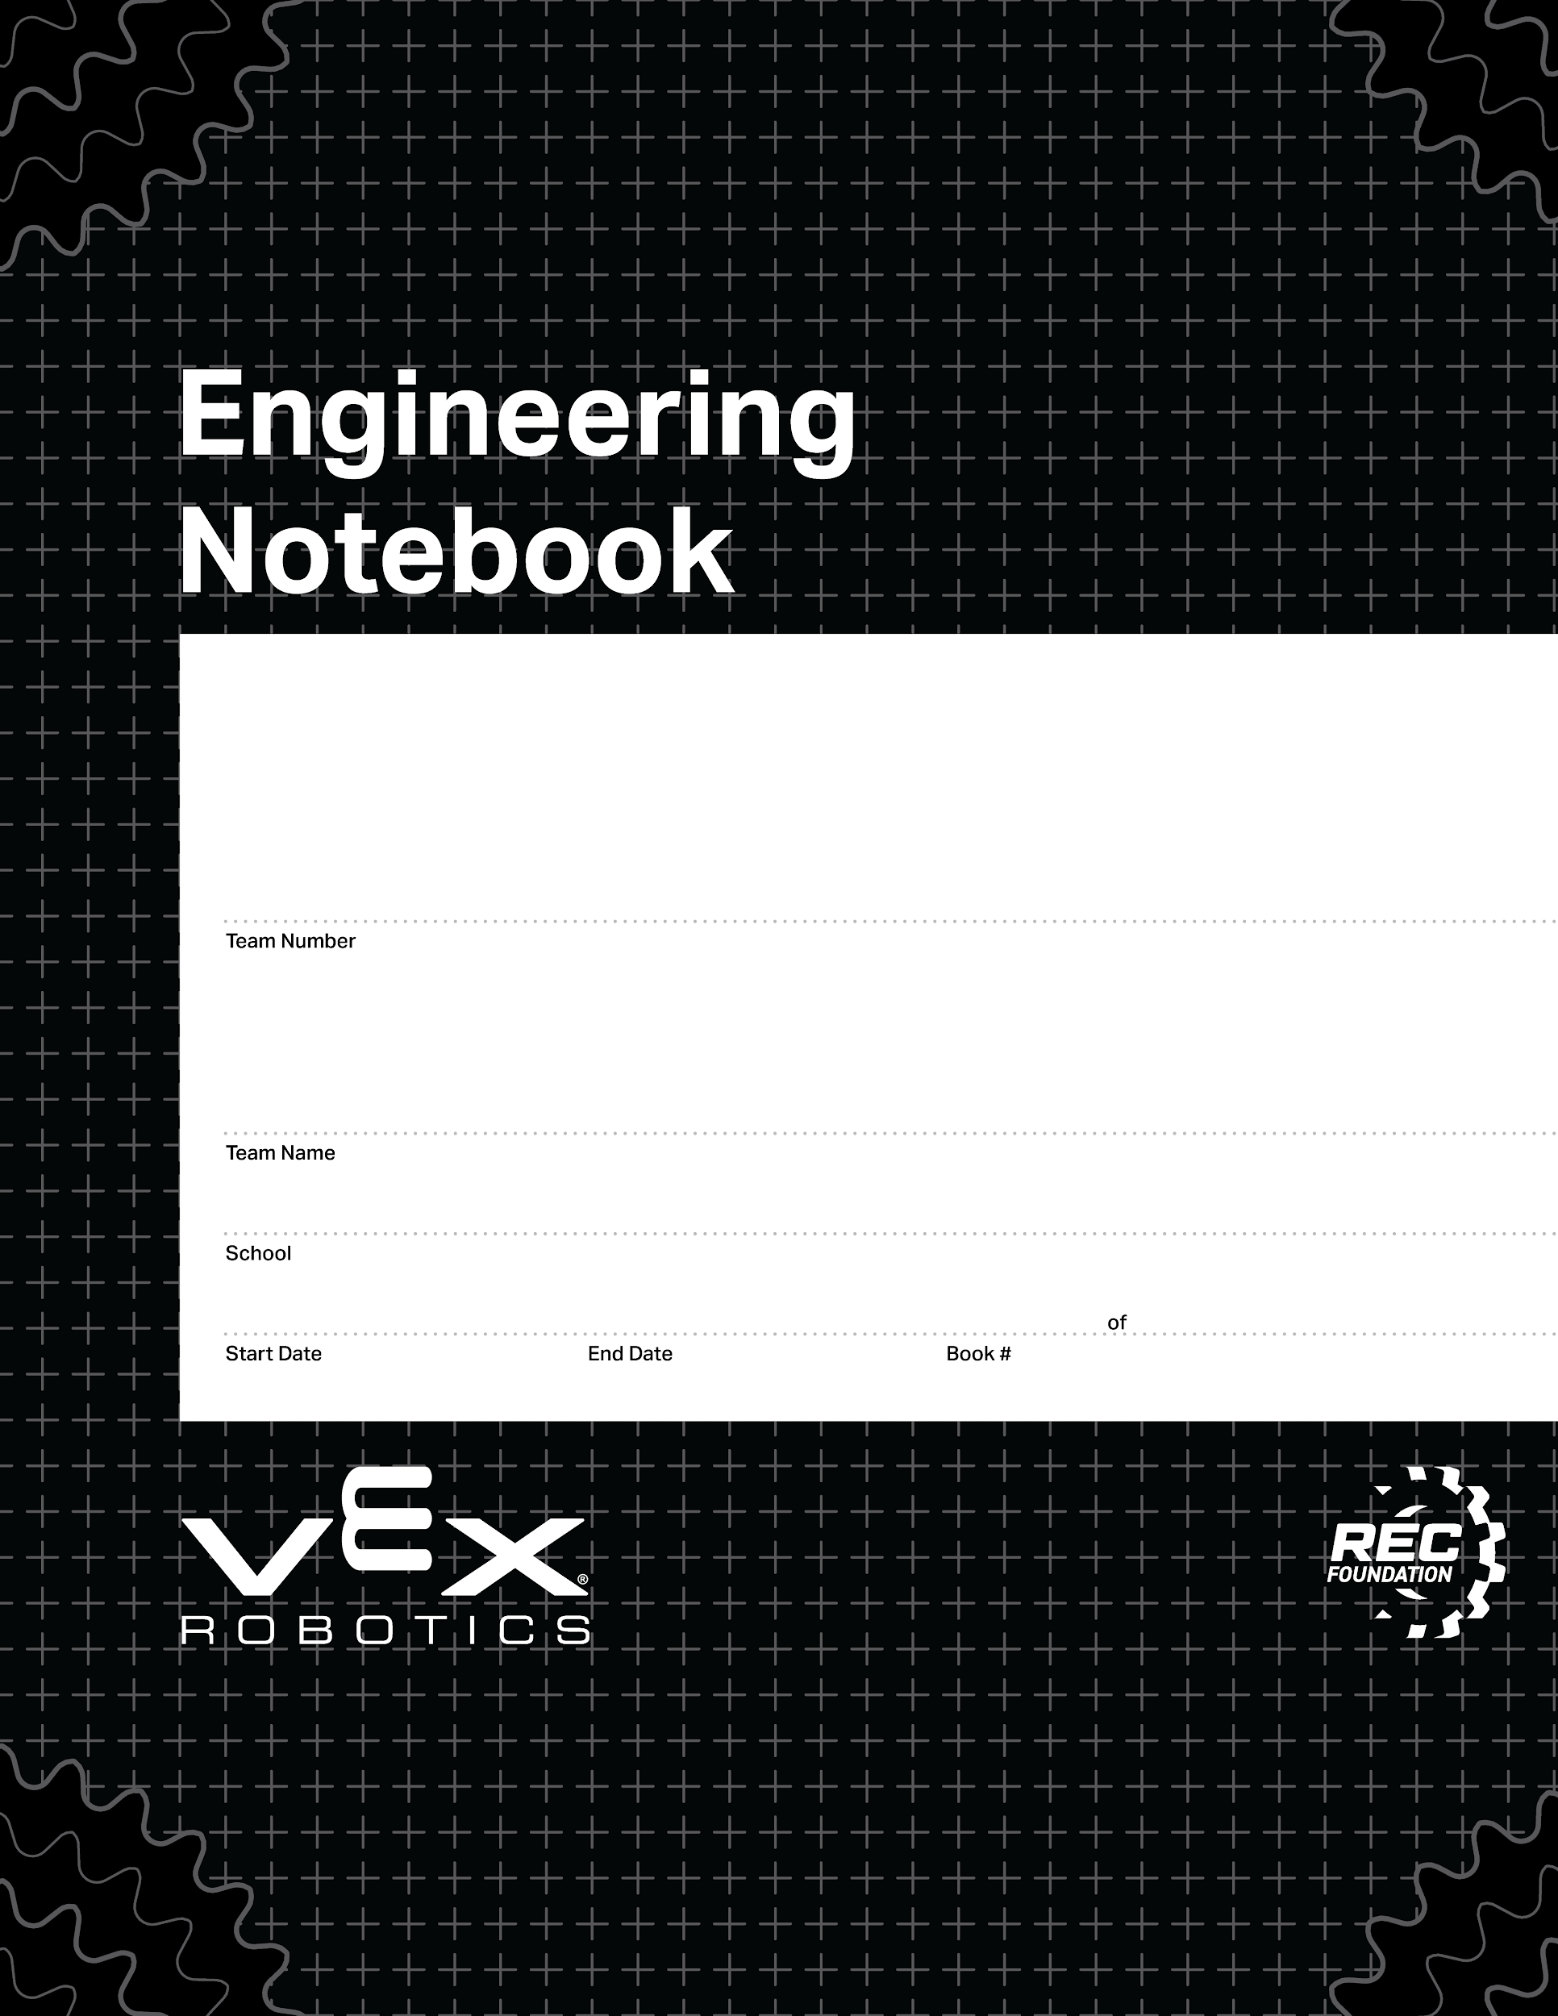
This is the basic notebook cover page.
0000
00/00/0000
00/00/0000
1
1
V2.1 Date 6.12.23

Slide 3
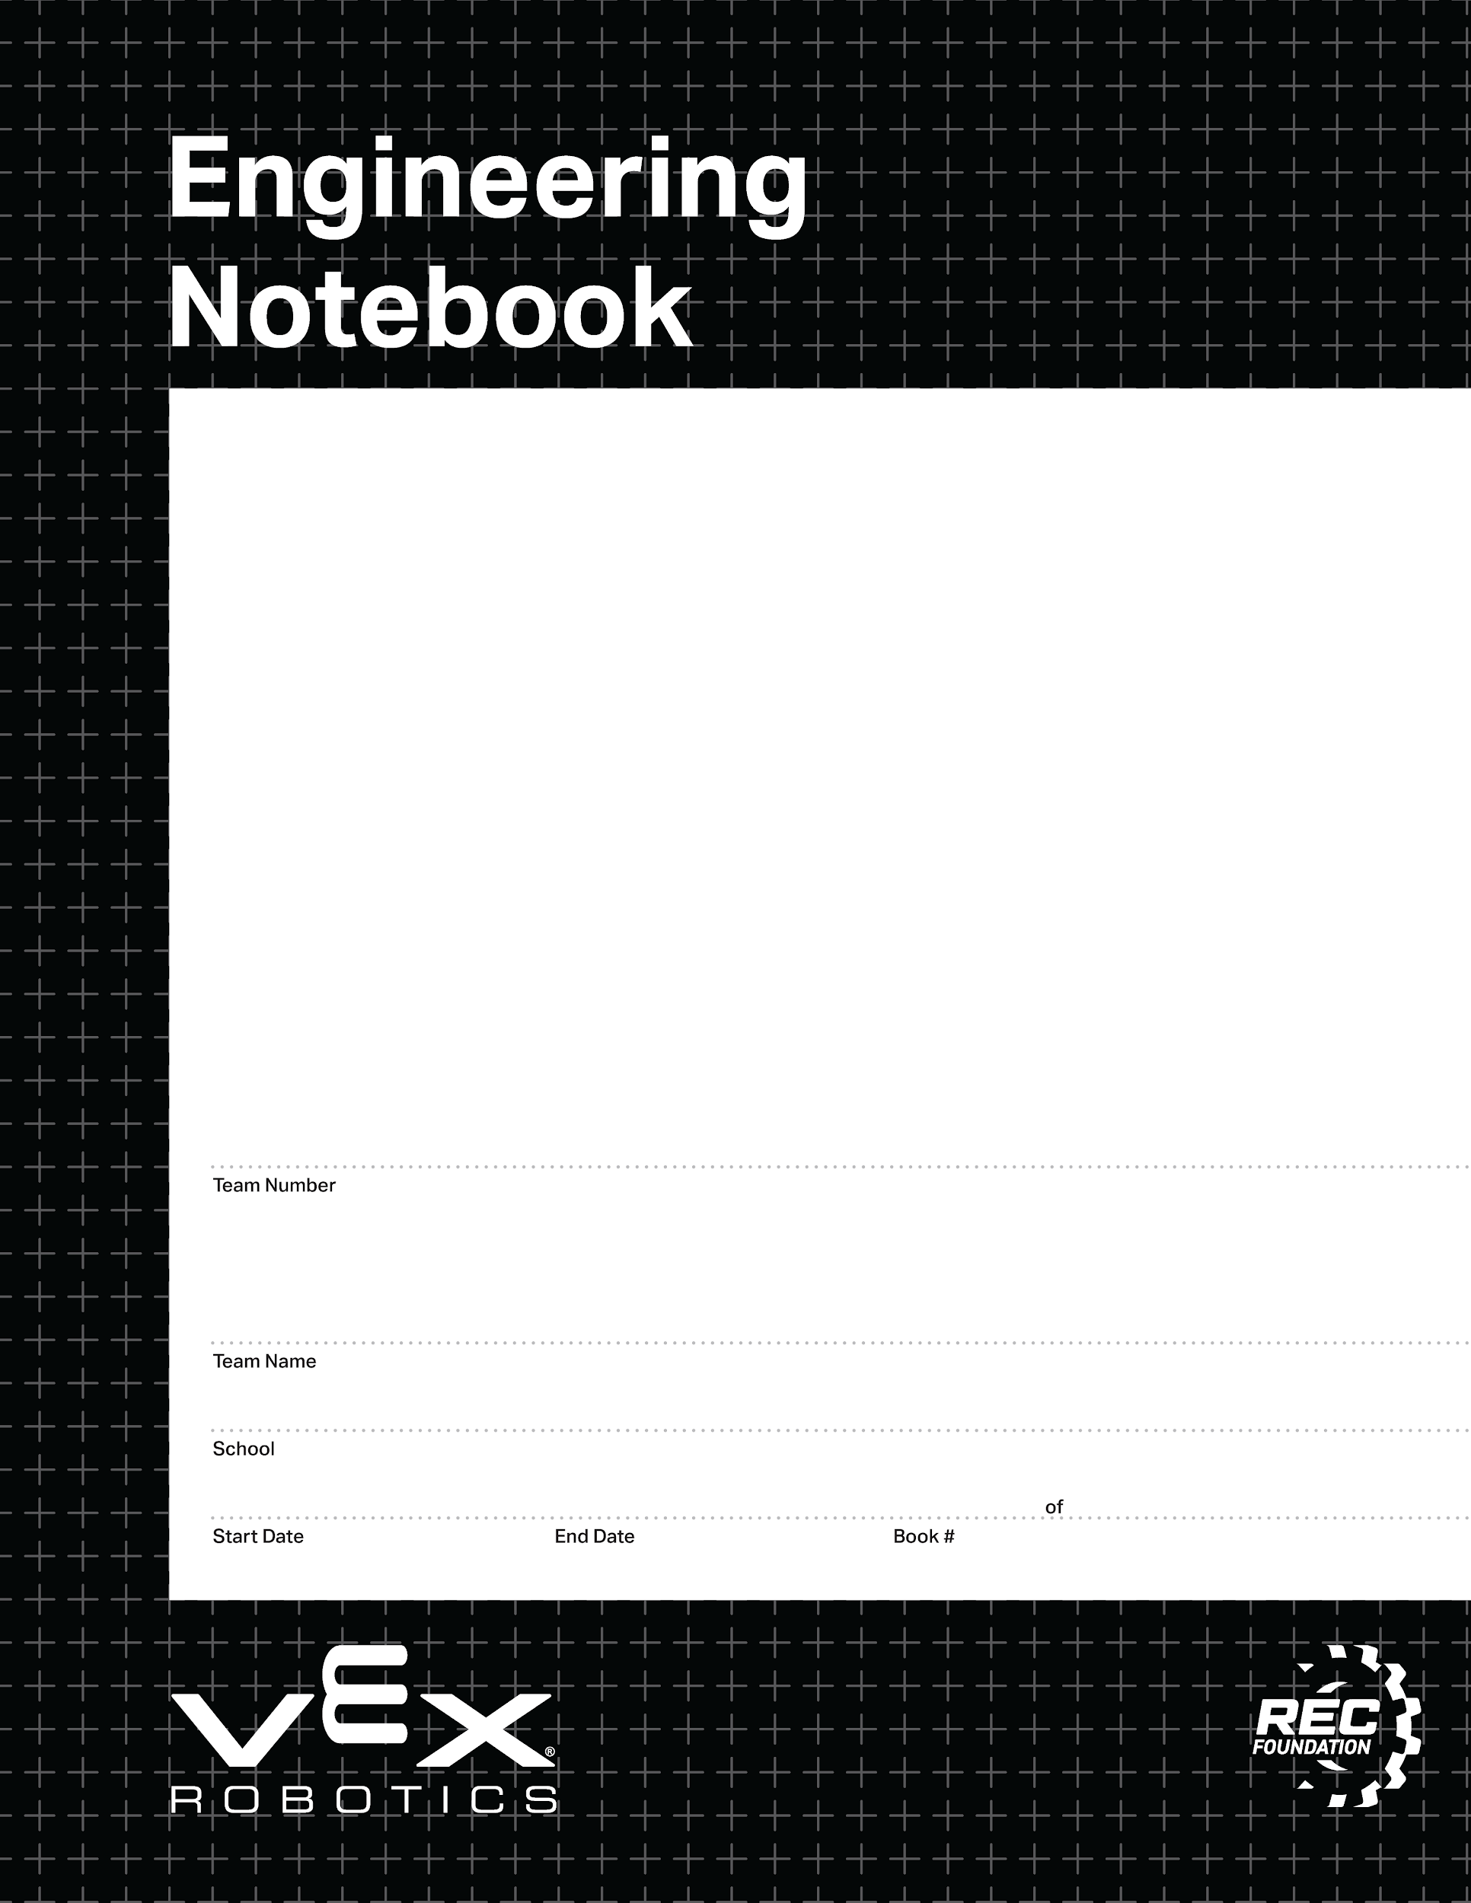
This is an alternate front page.
Place a team photo or other information here.
0000
00/00/0000
00/00/0000
1
1
V2.1 Date 6.12.23

Slide 4
This is an alternate front page.
Place a team photo or other information here.
Right click me and select “Format Background” and then choose your team’s favorite color!
0000
00/00/0000
00/00/0000
1
1
V2.1 Date 6.12.23

Slide 5
This is an alternate front page.
Place a team photo or other information here.
Right click me and select “Format Background” and then choose your team’s favorite color!
0000
00/00/0000
00/00/0000
1
1
V2.1 Date 6.12.23

Slide 6

Resources
engineering.vex.com
notebooking.vex.com
coding.vex.com
Judging Rubric for Notebooks
vex.com
roboticseducation.org
VRC 2023-2024 Game - Rules & Game Video
Send suggestions and comments about these Digital Notebooks and Digital Parts
to notebooks@vex.com

Slide 7
12345 Title Title Title Date Date Date

Slide 10
Section A

Slide 15
PORT
PORT
PORT
PORT
PORT
PORT
PORT
PORT
PORT
PORT
PORT
PORT
PORT
PORT
PORT
PORT
PORT
PORT
PORT
PORT
PORT
PORT
PORT
PORT
PORT
PORT
PORT
PORT
PORT

Slide 16
BUMPER
BUMPER
BUMPER
BUMPER
STICK
STICK
STICK
STICK
BUTTON
BUTTON
BUTTON
BUTTON
BUTTON
BUTTON
BUTTON
BUTTON

Slide 19



The game objects on this page are moveable
These tri-balls are underneath the bar. They are placed on top on this slide so they be can moved.

Slide 20
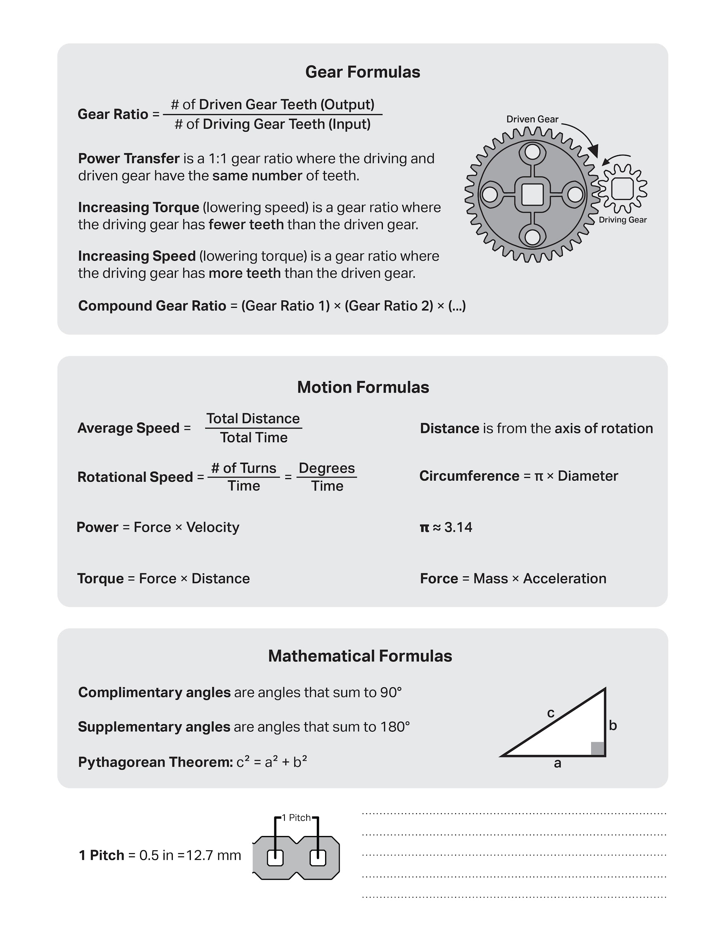

Slide 21
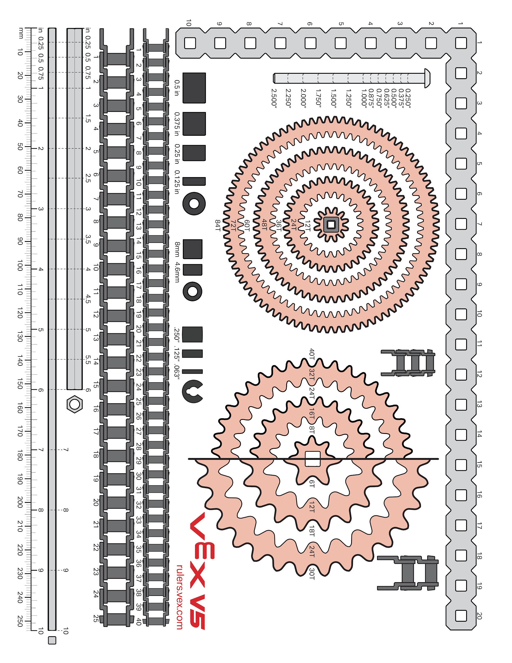

Slide 22
Week of: MM/DD/YYYY

Slide 23
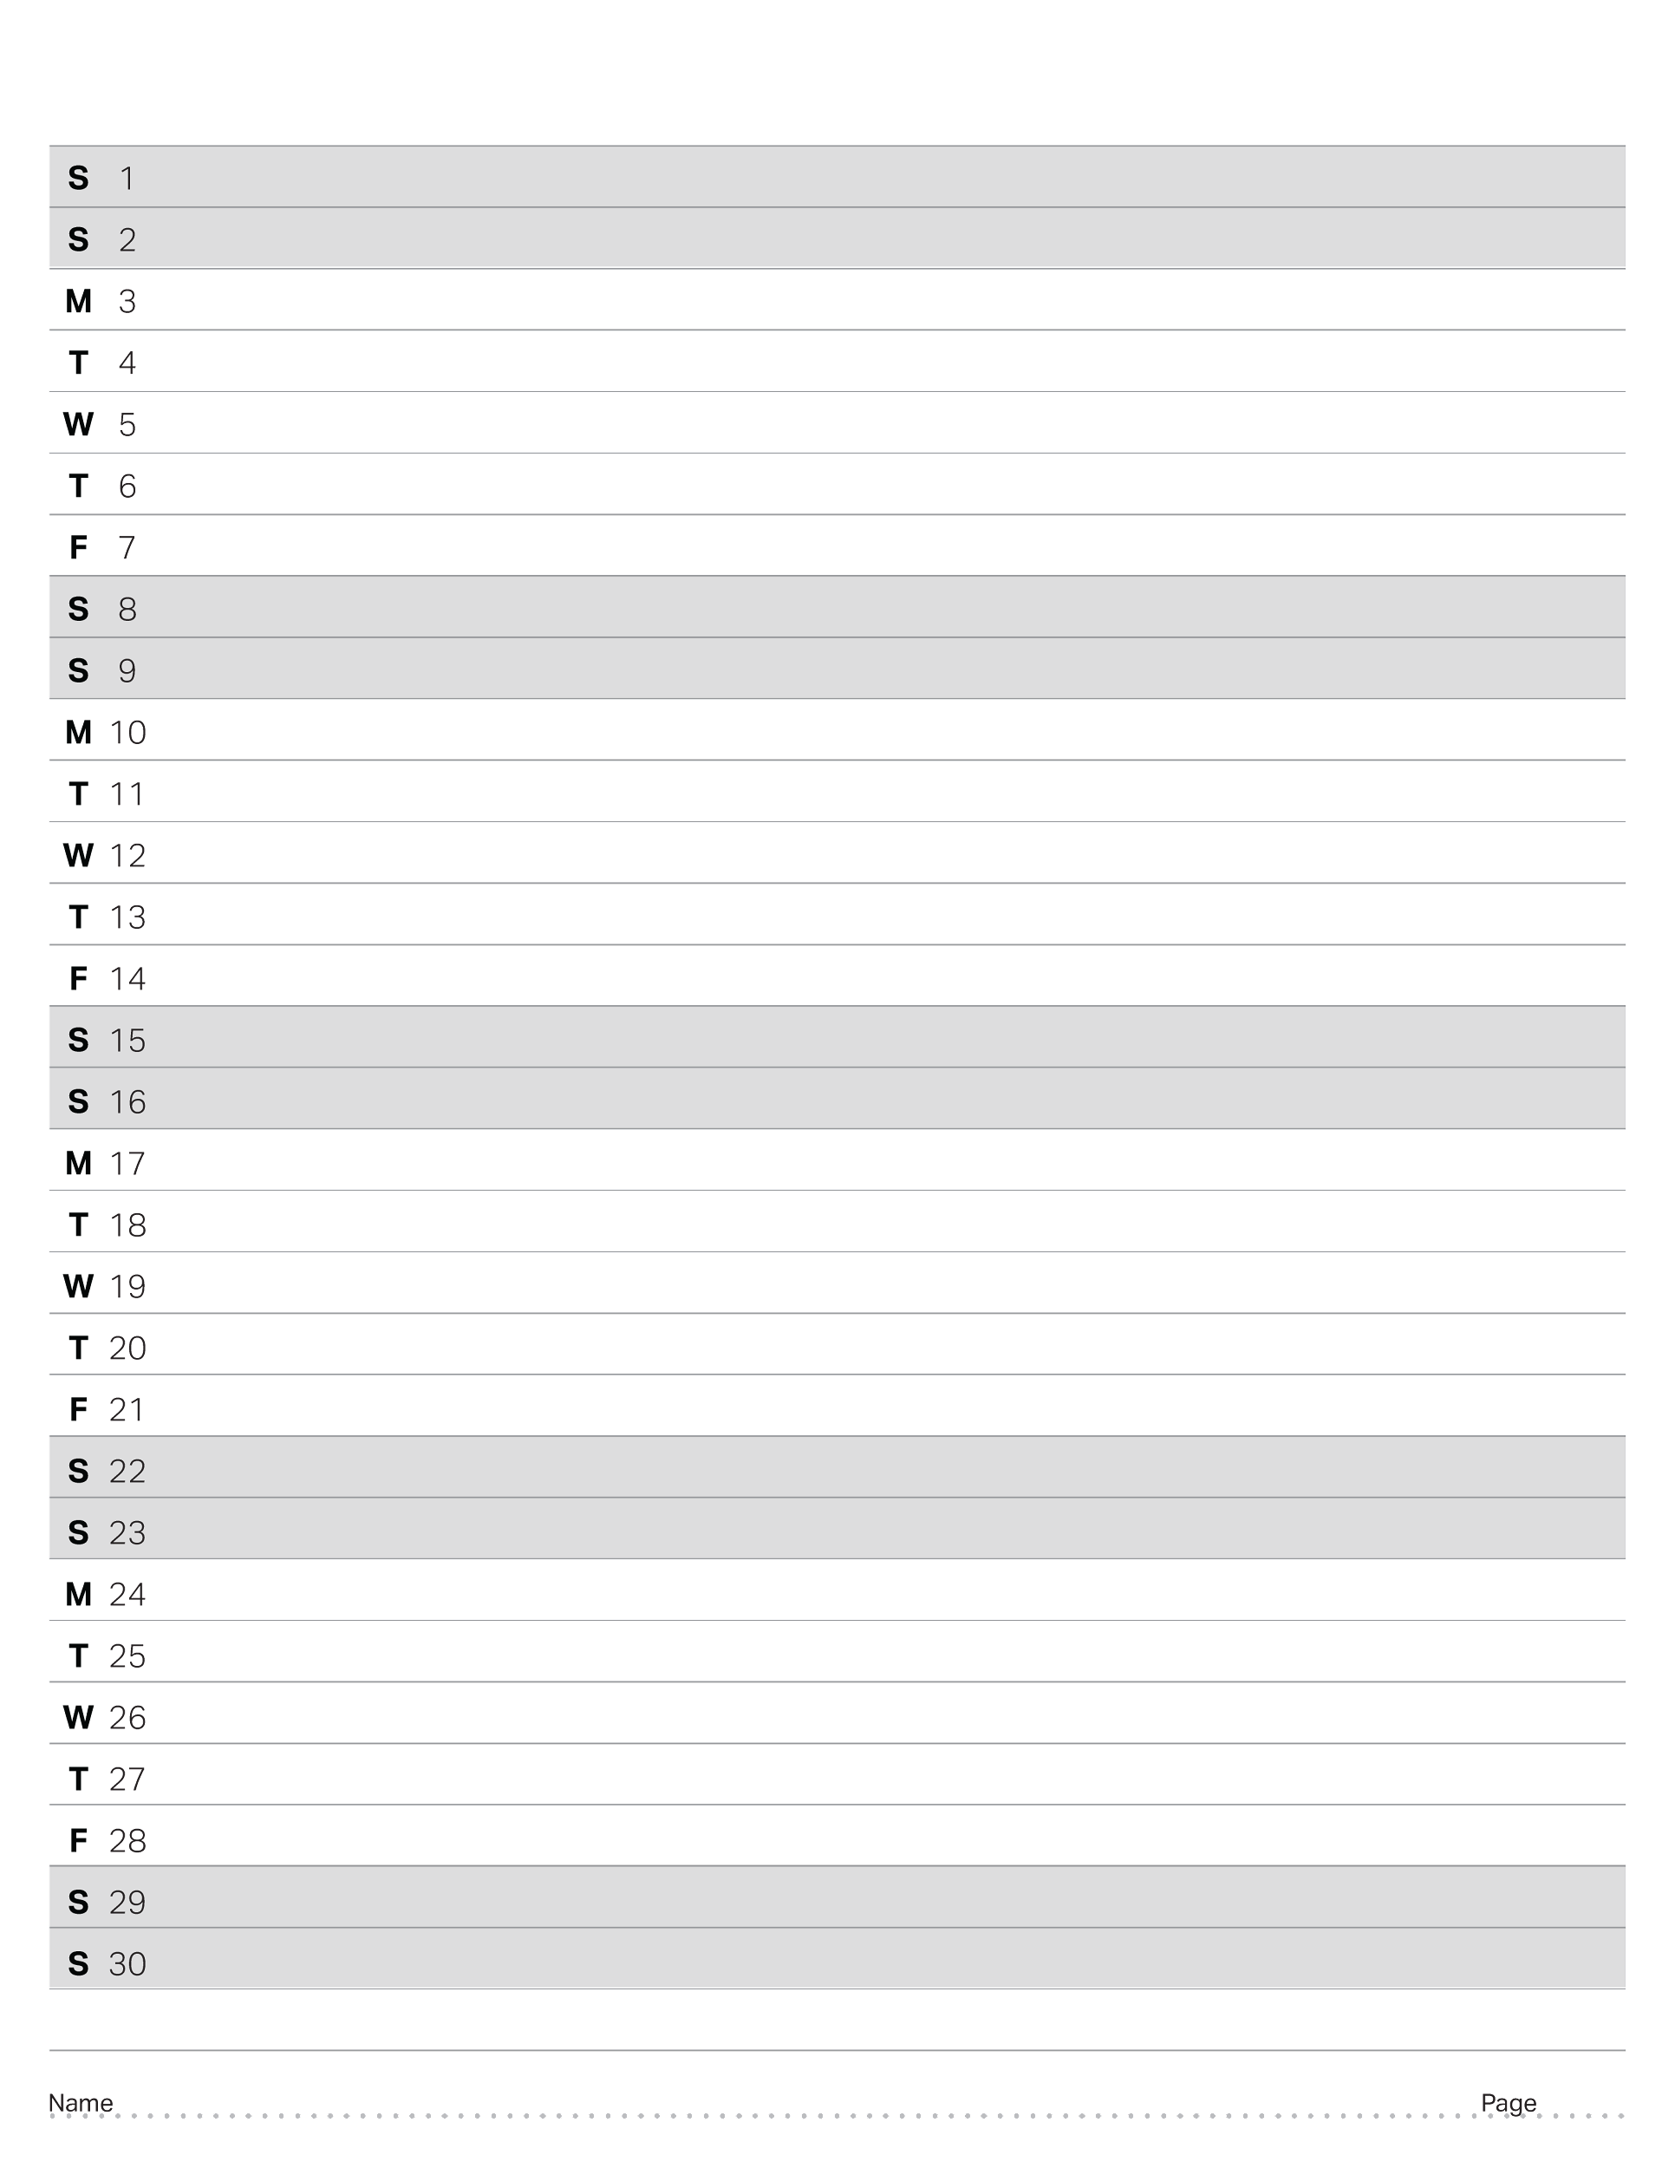
April 2023

Slide 24
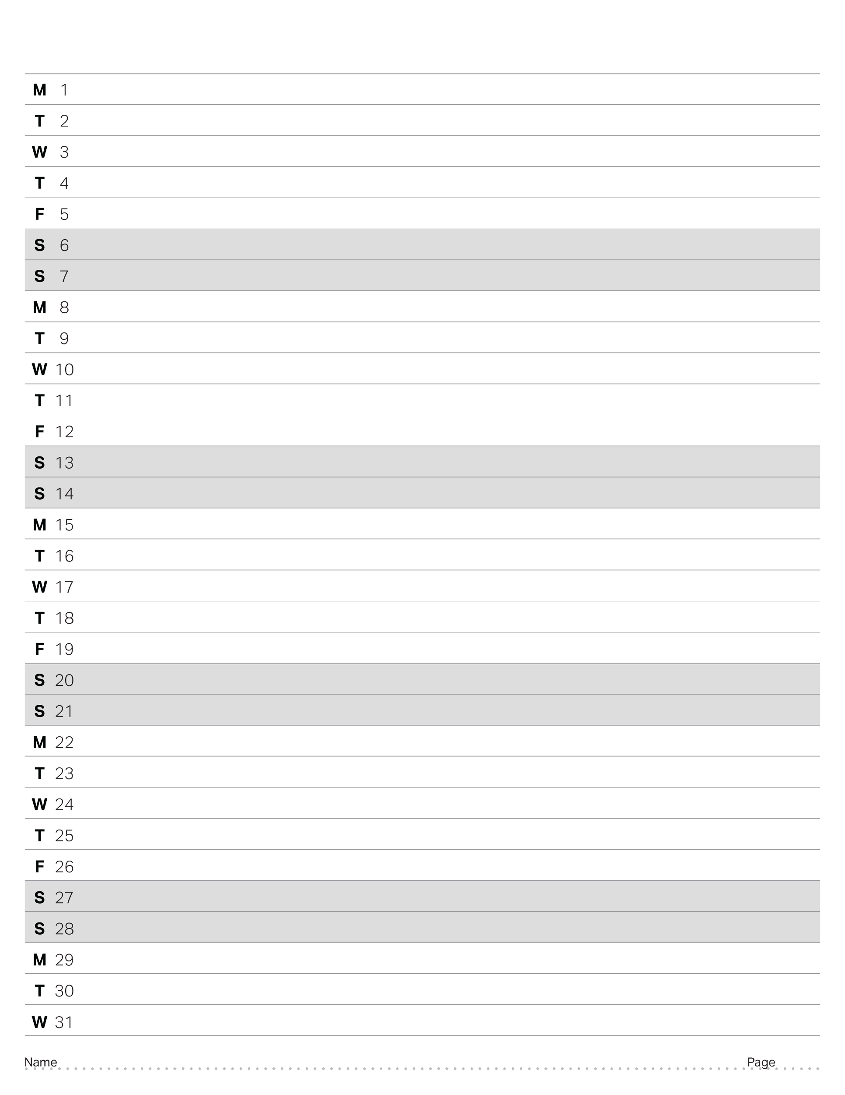
May 2023

Slide 25
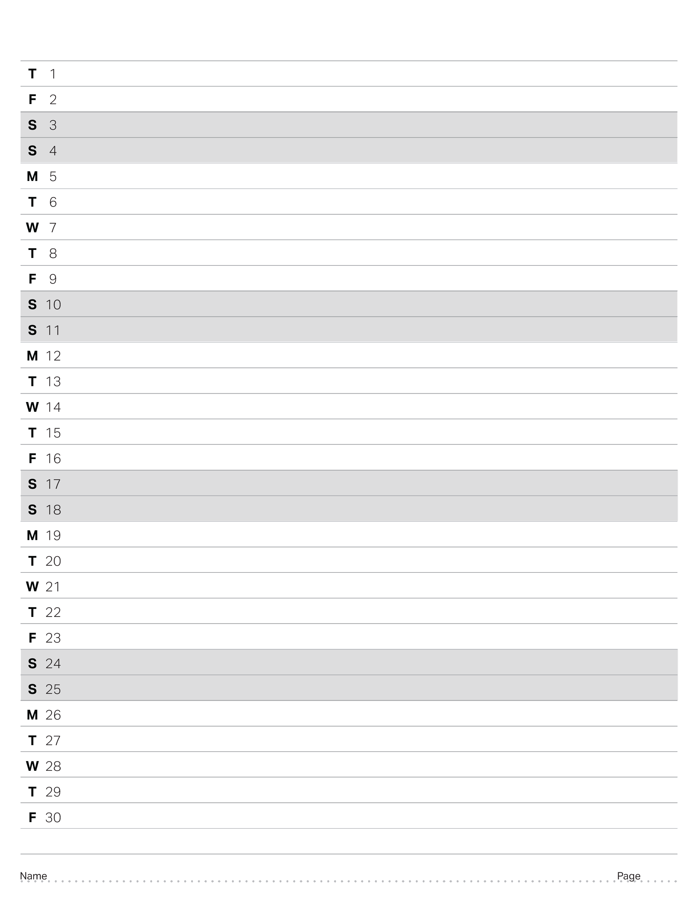
June 2023

Slide 26
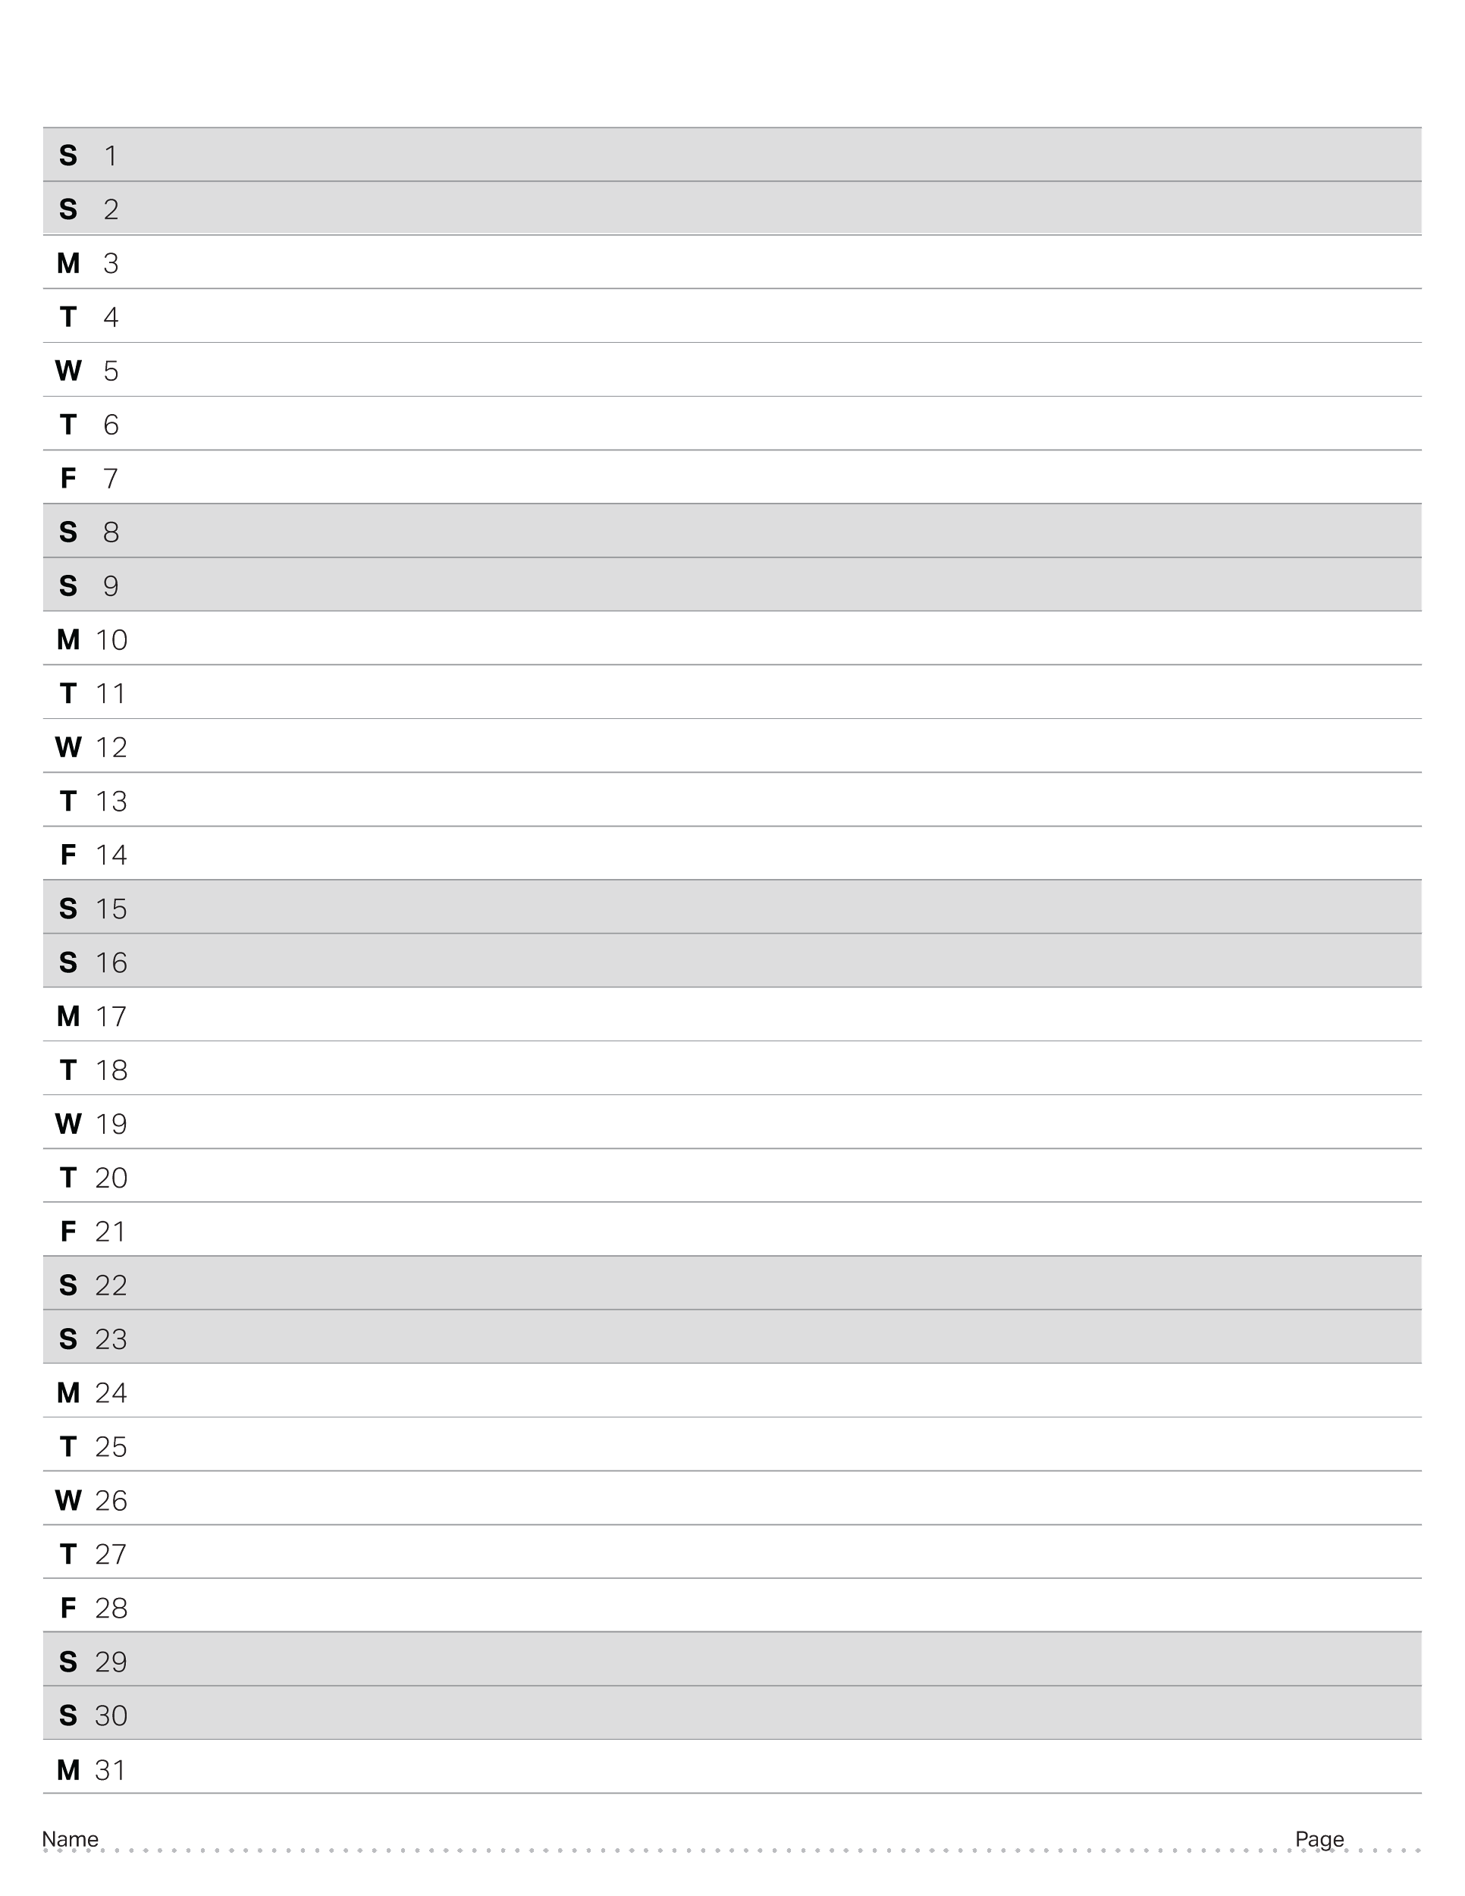
July 2023

Slide 27
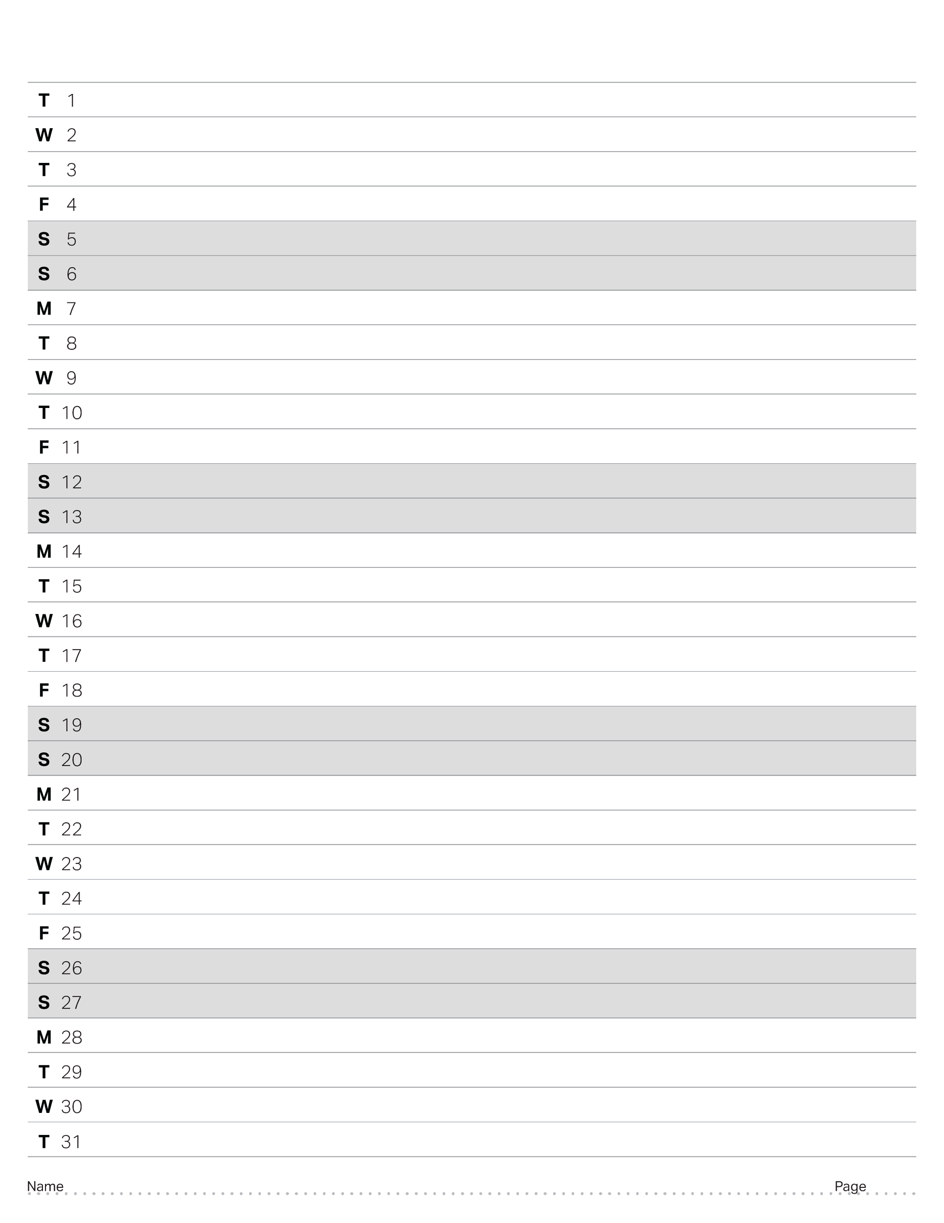
August 2023

Slide 28
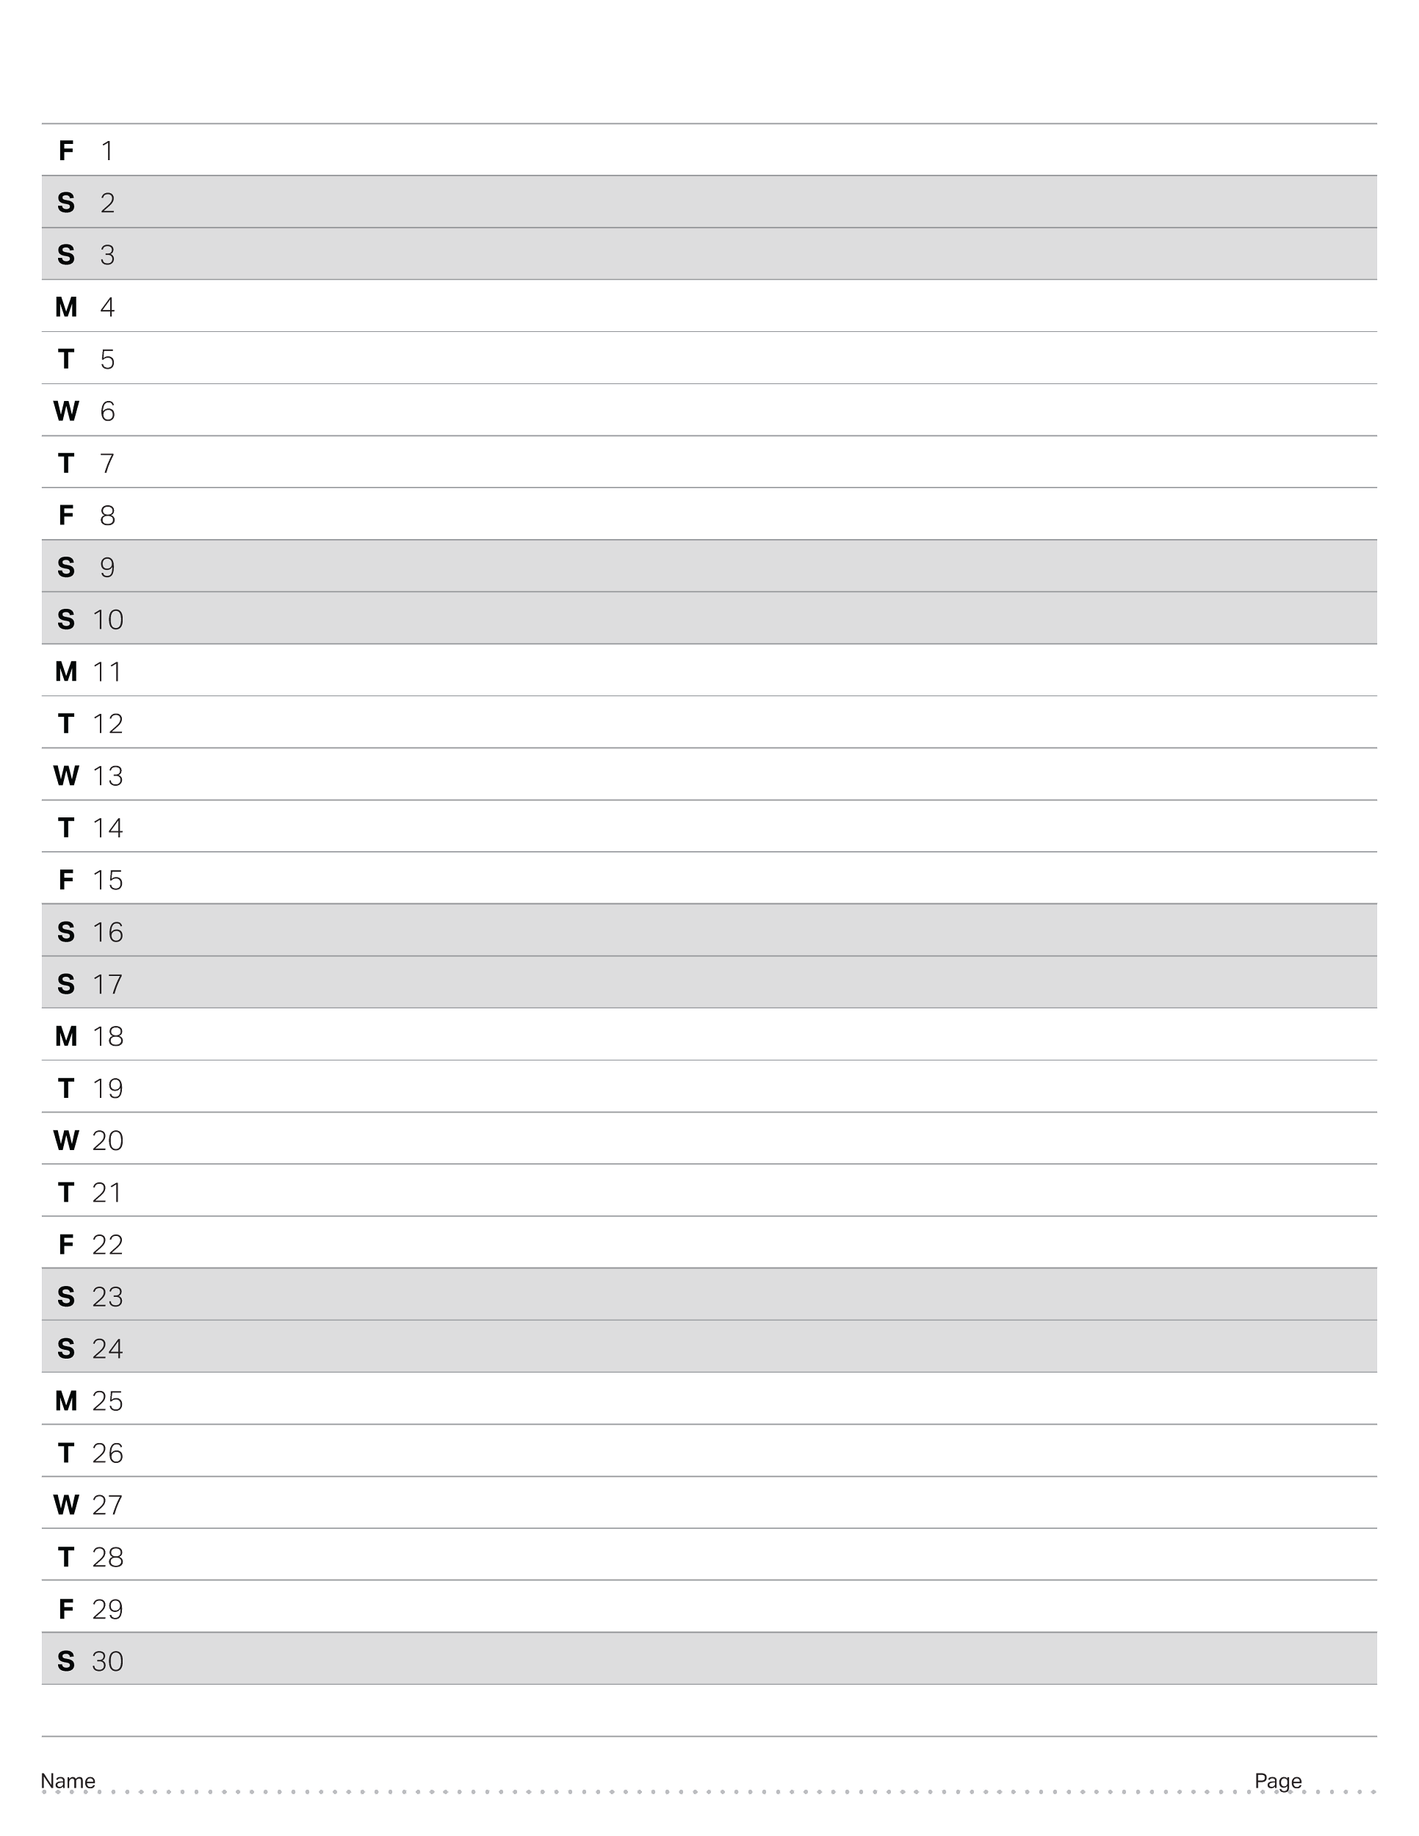
September 2023

Slide 29
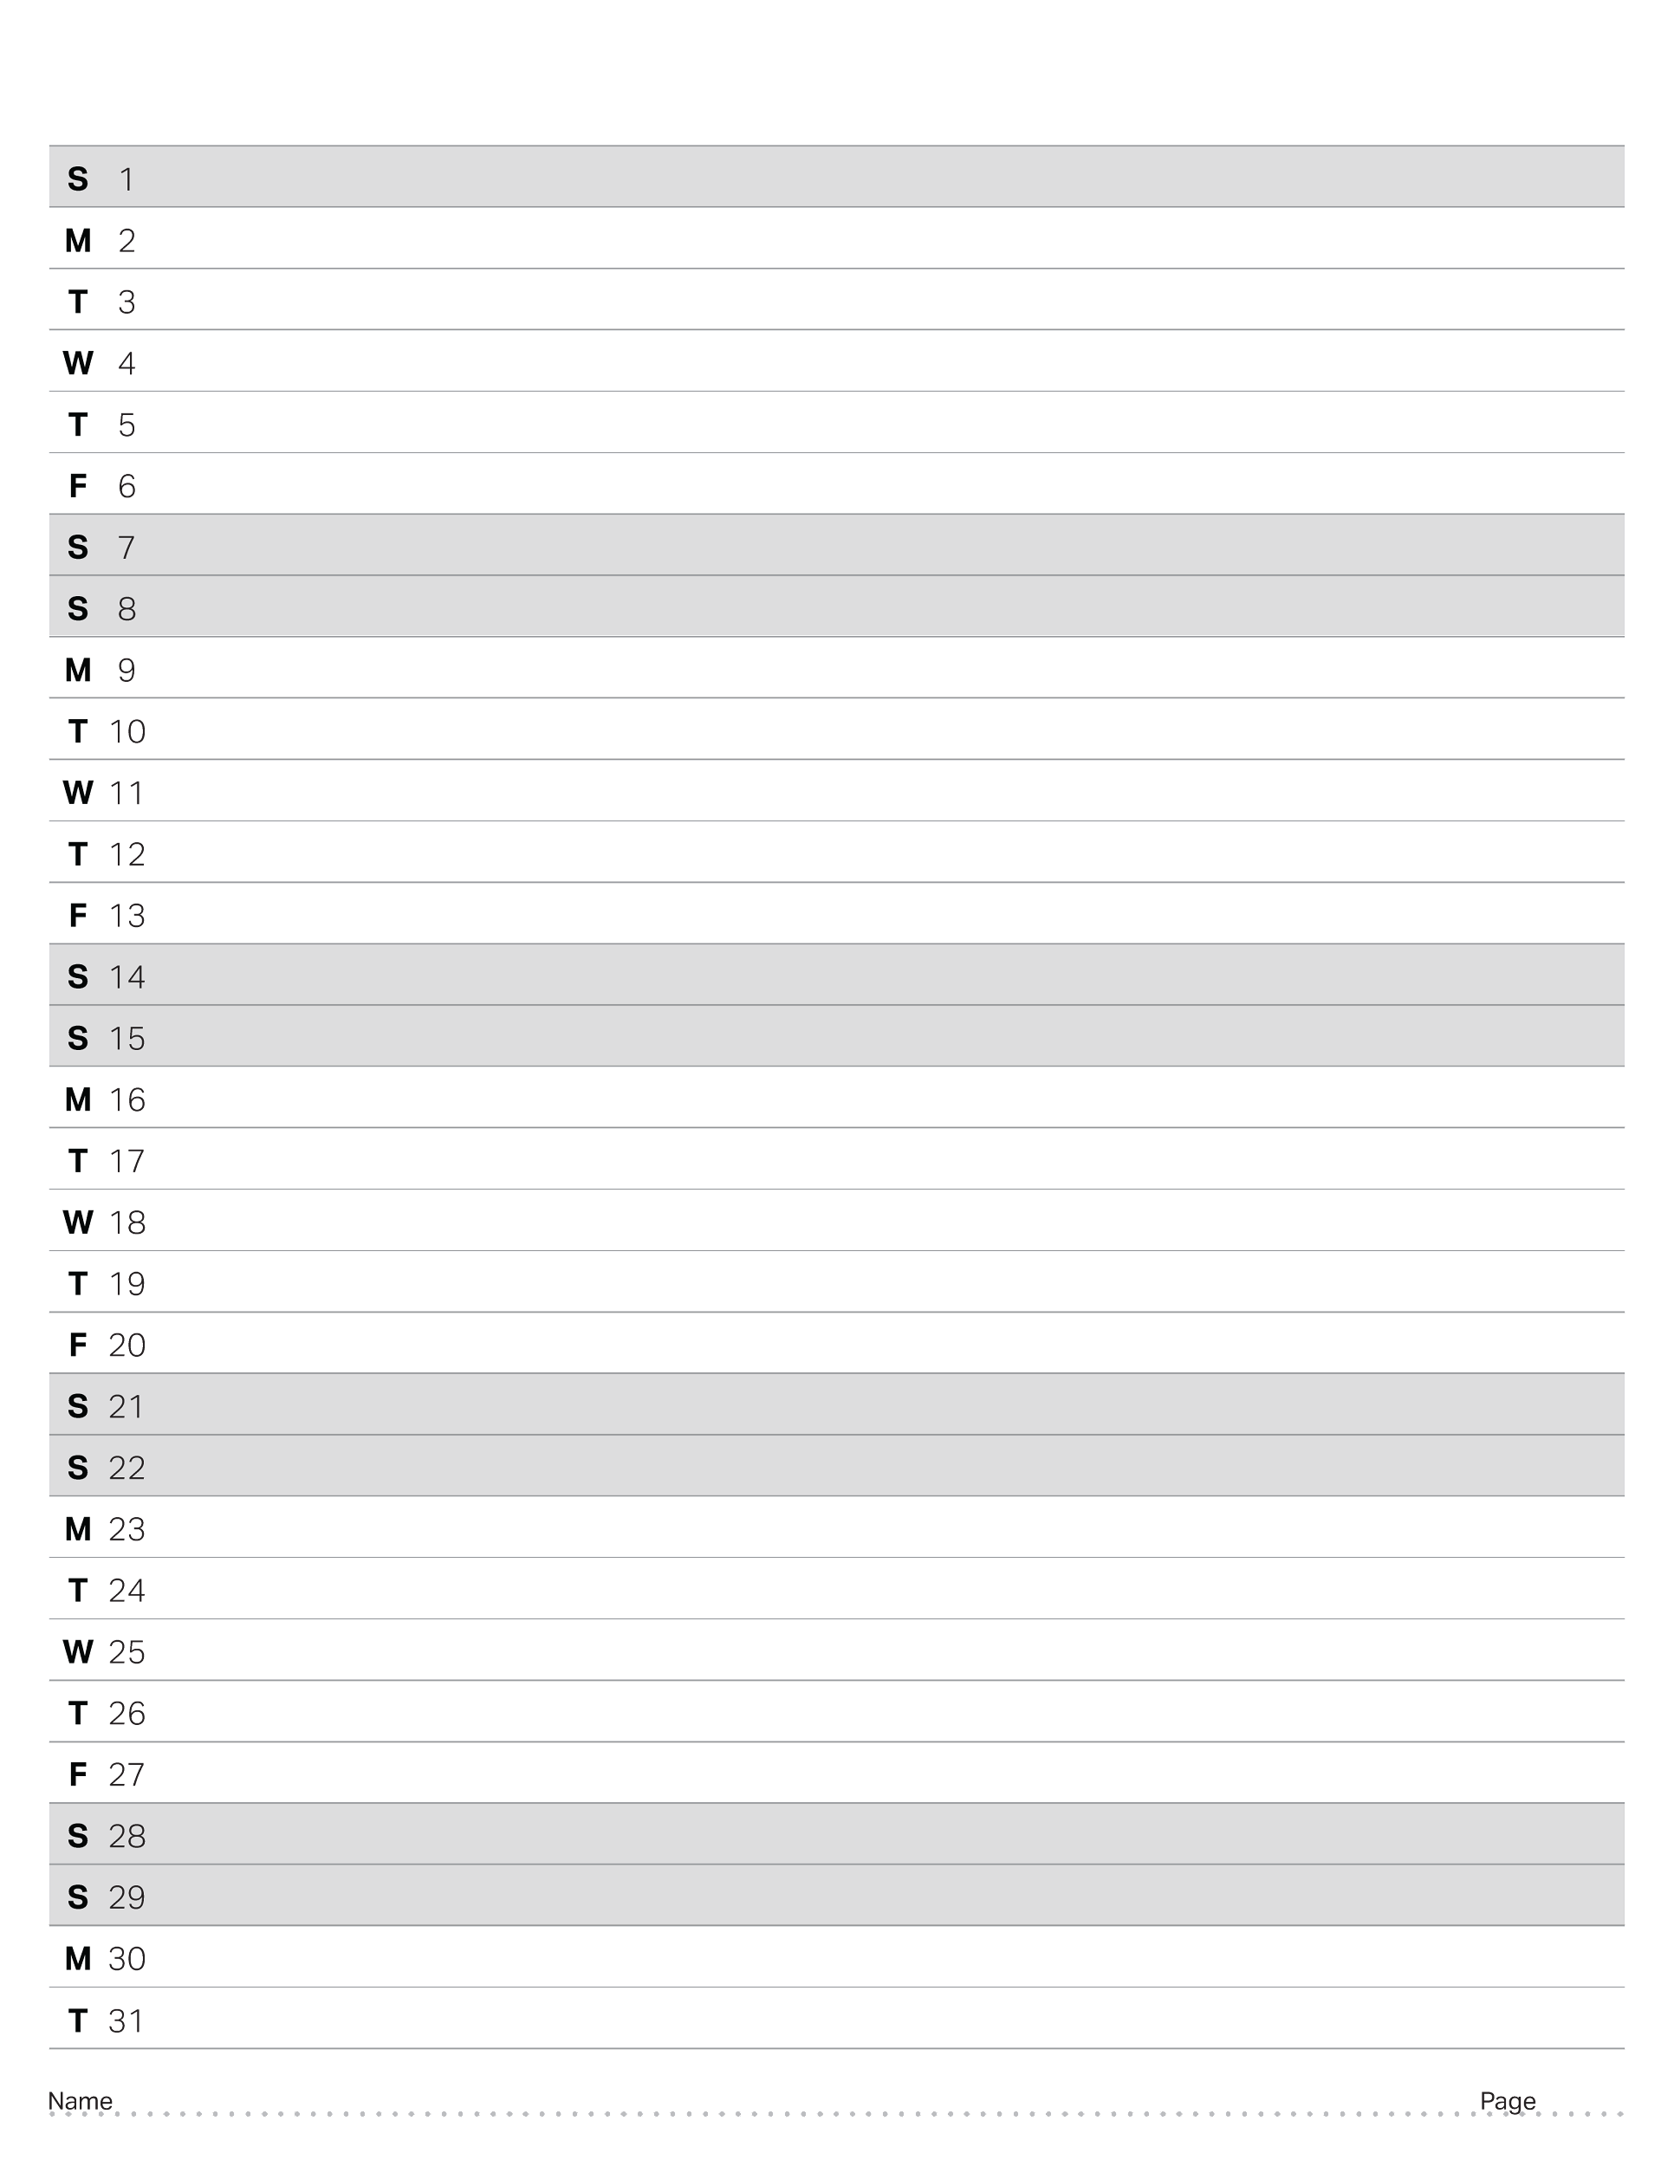
October 2023

Slide 30
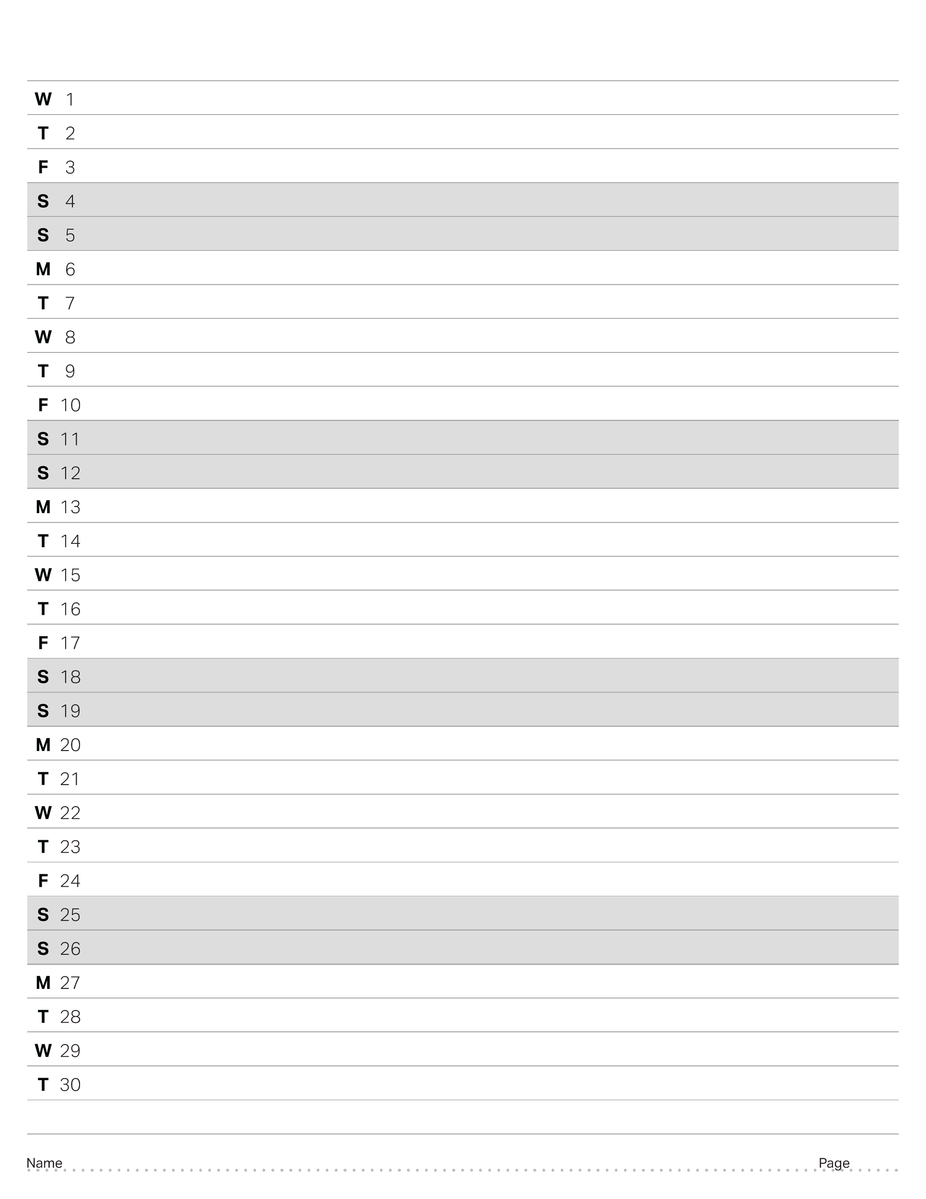
November 2023

Slide 31
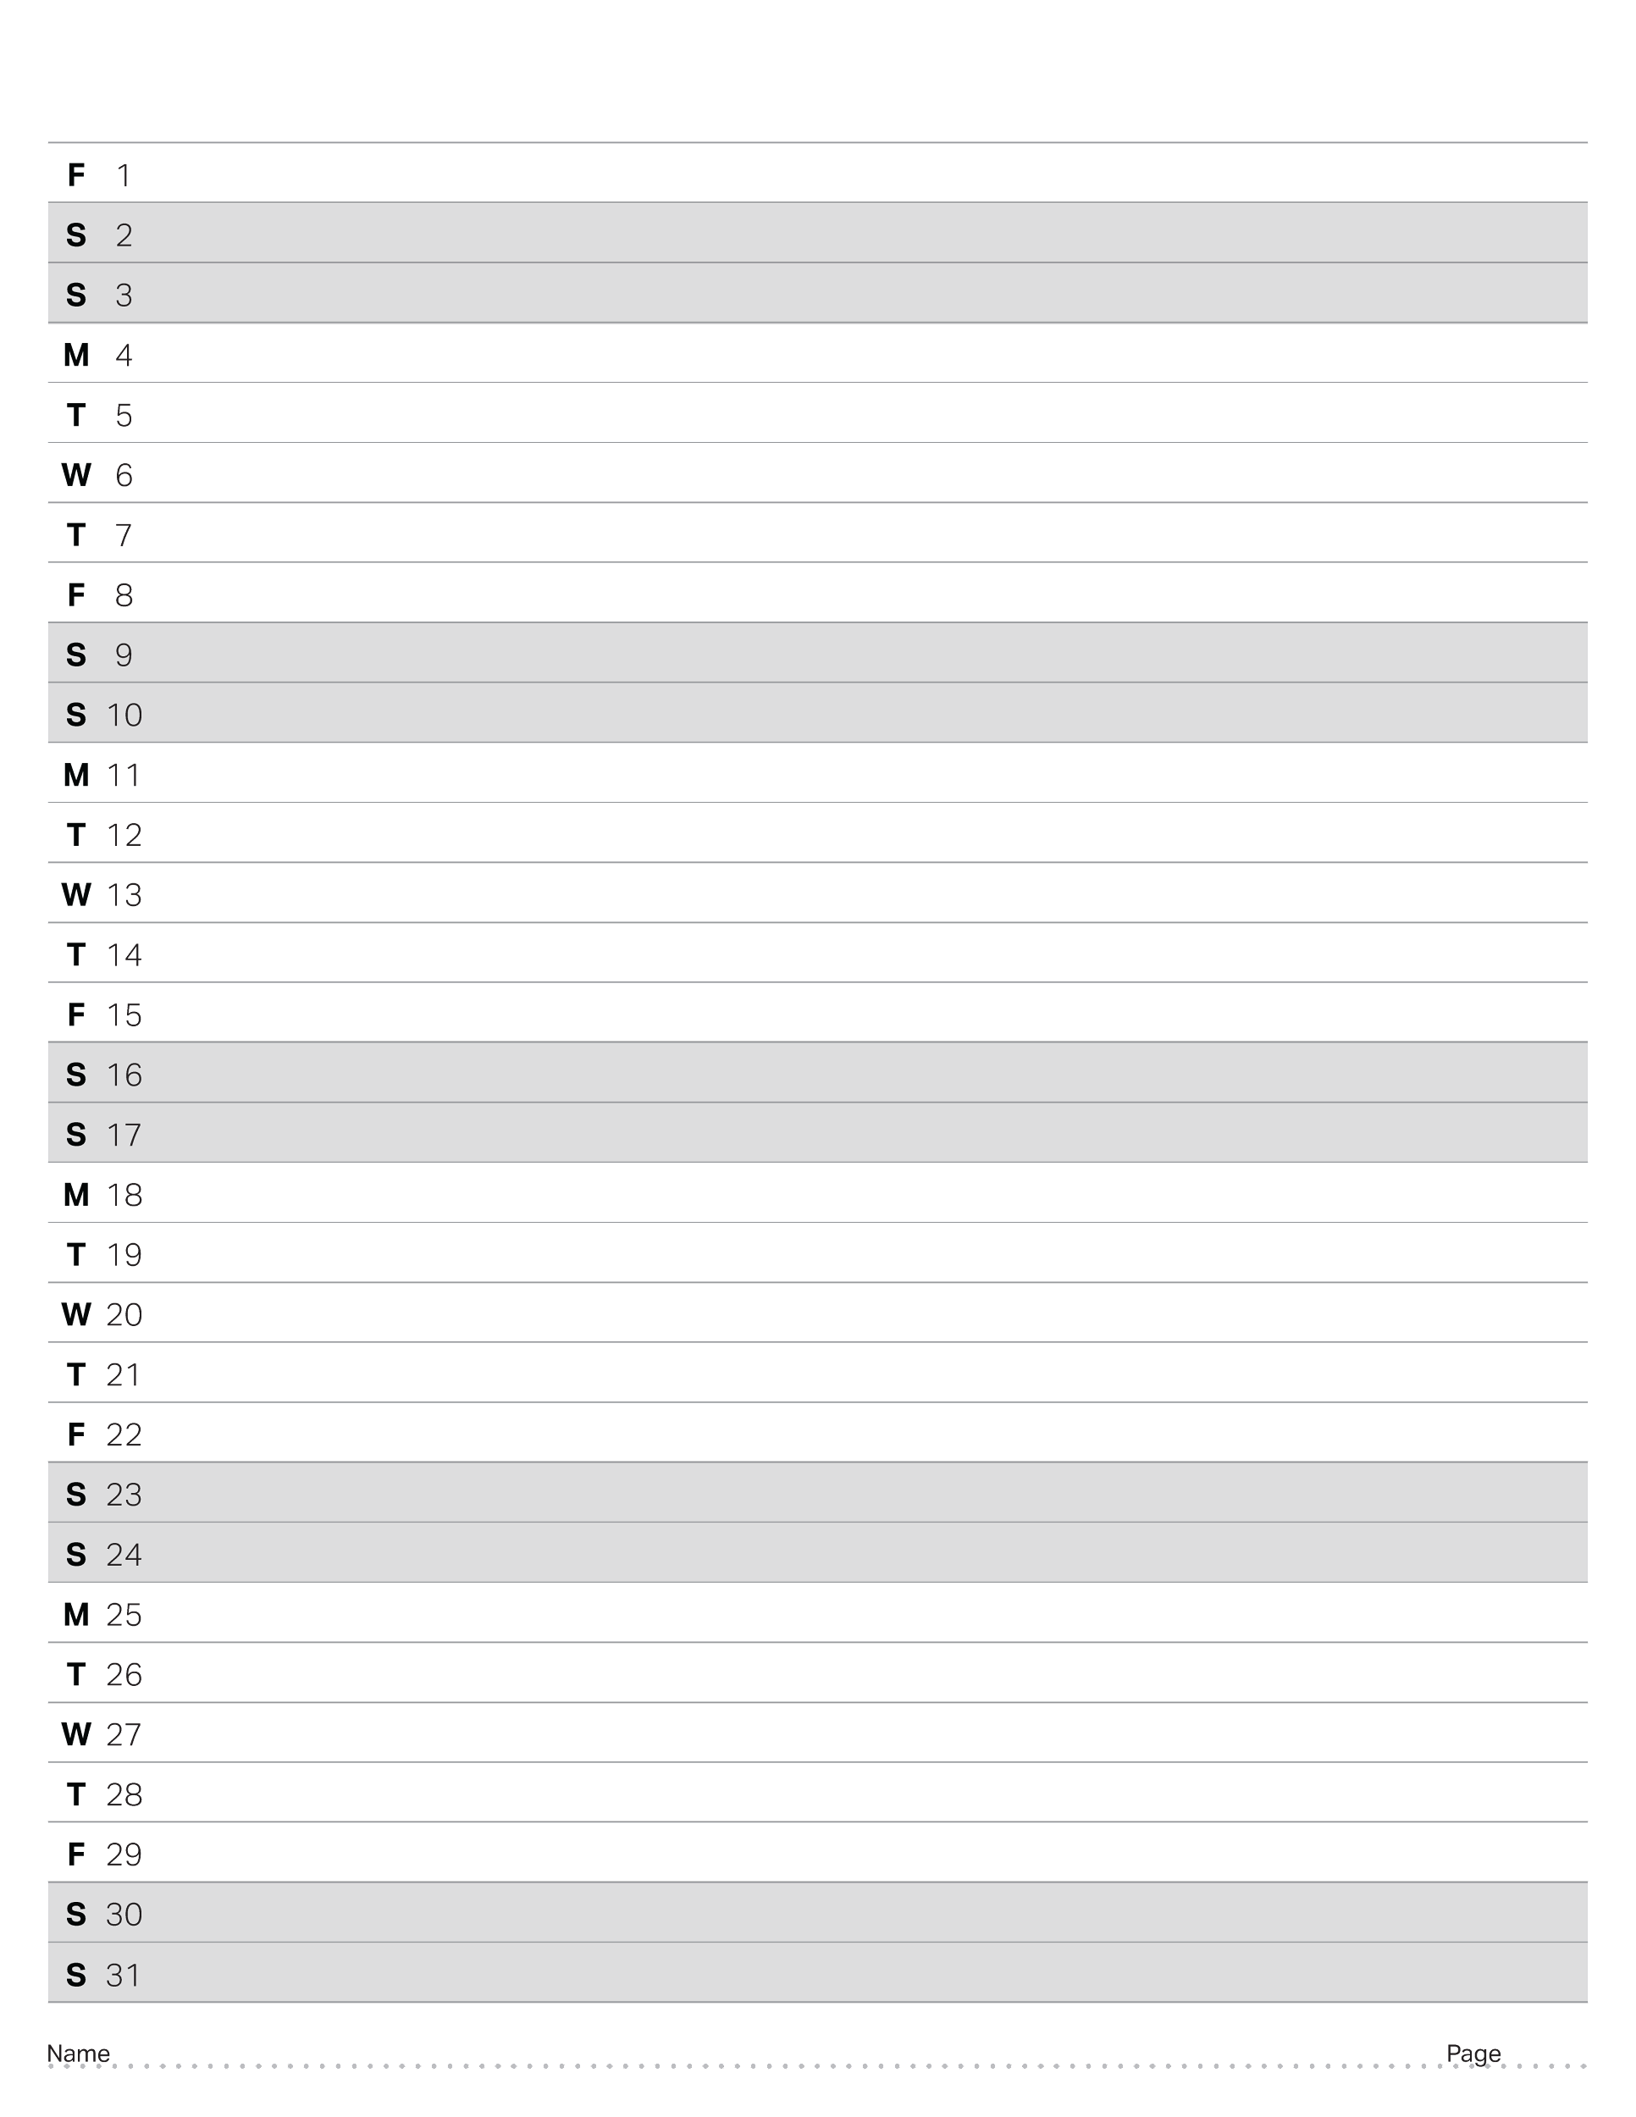
December 2023

Slide 32
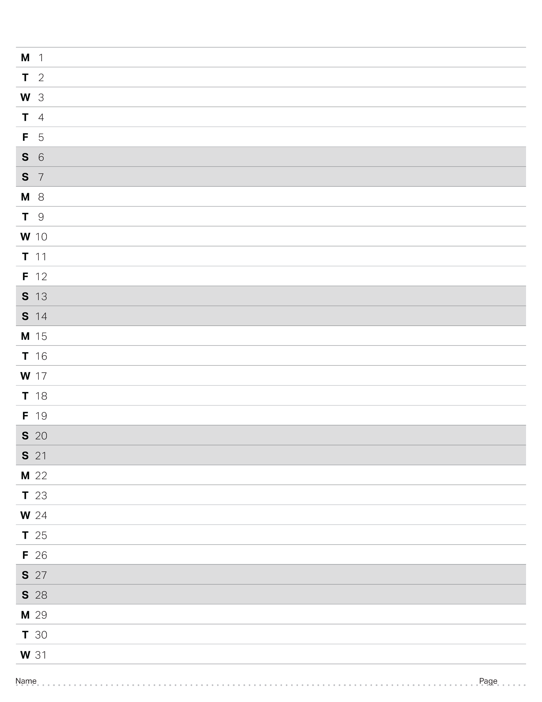
January 2024

Slide 33
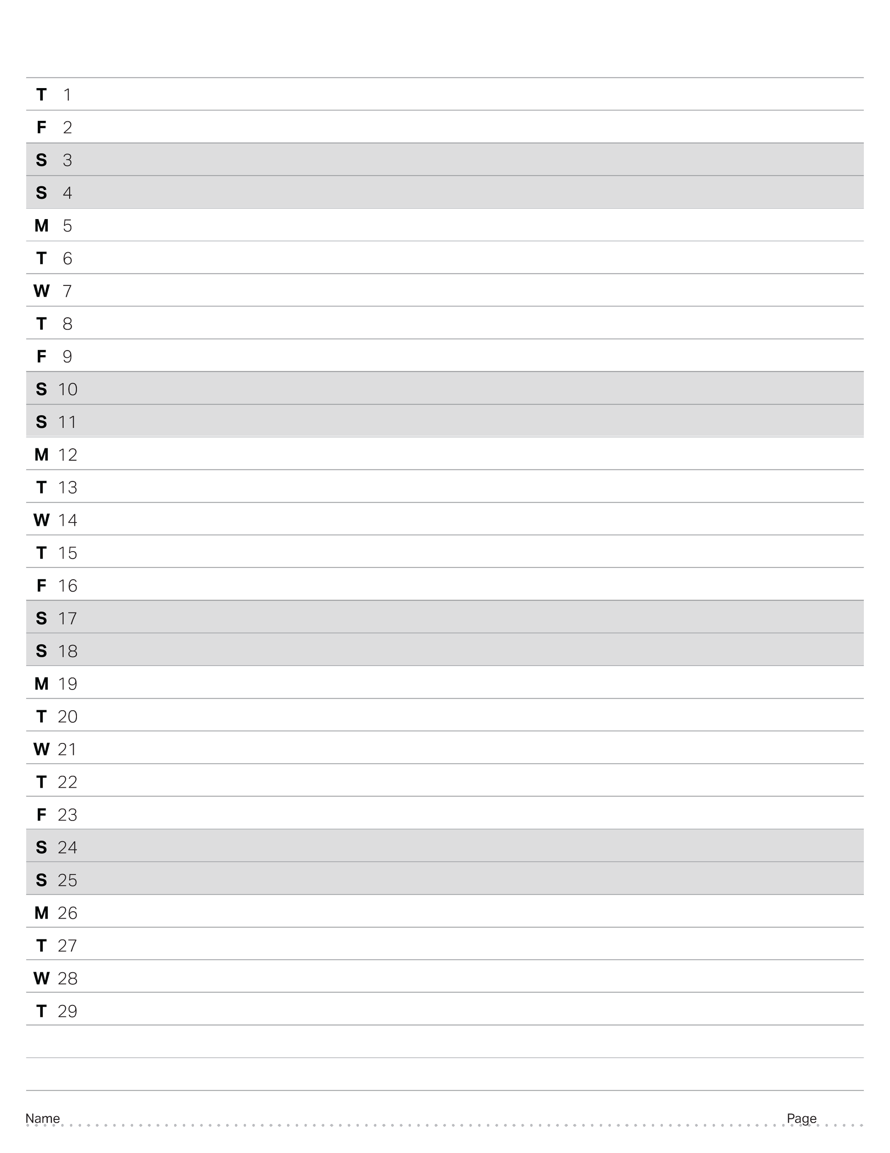
February 2024

Slide 34
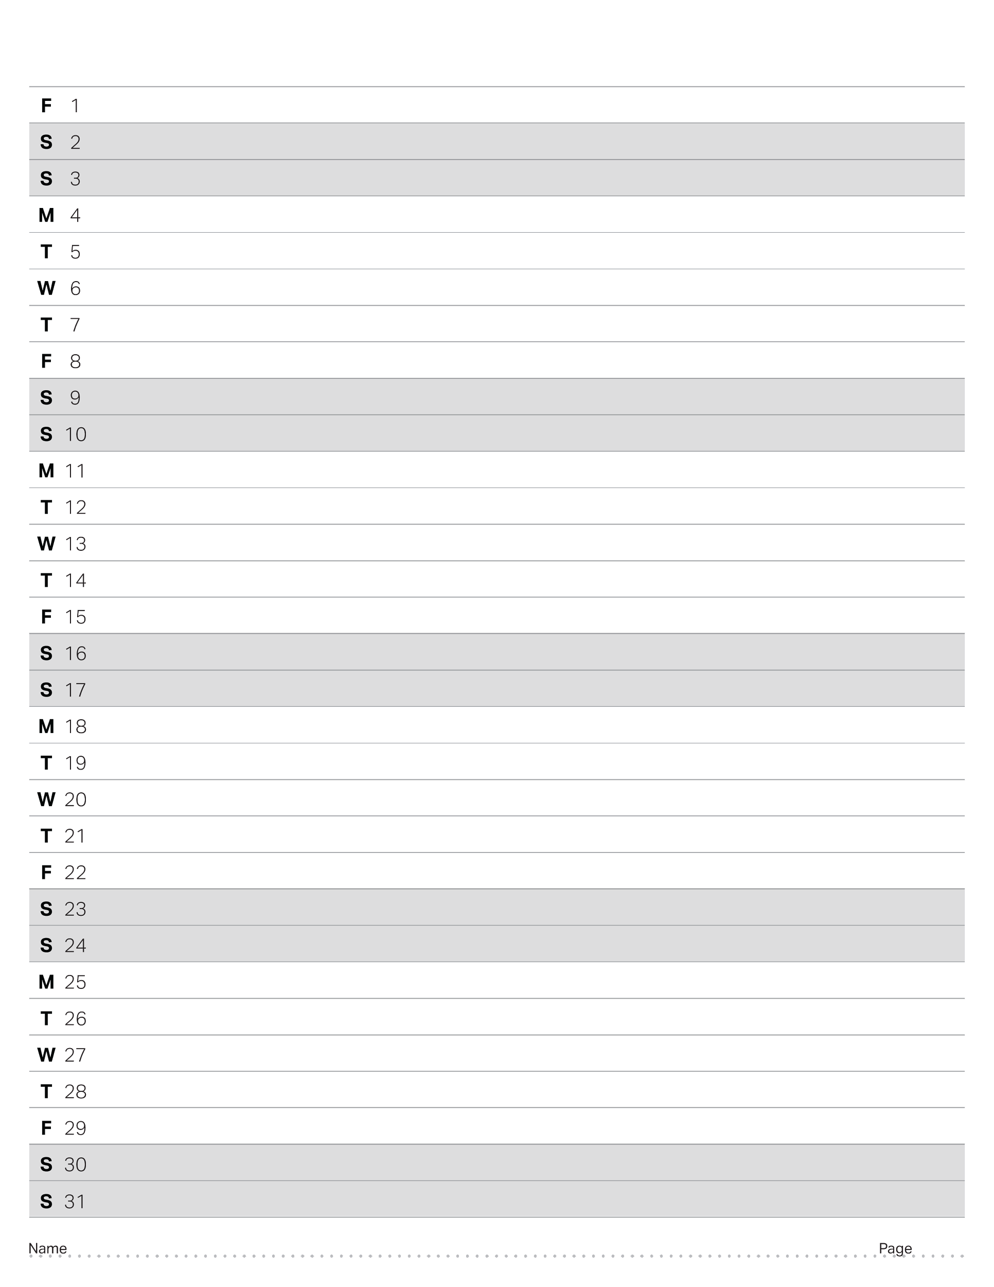
March 2024

Slide 35
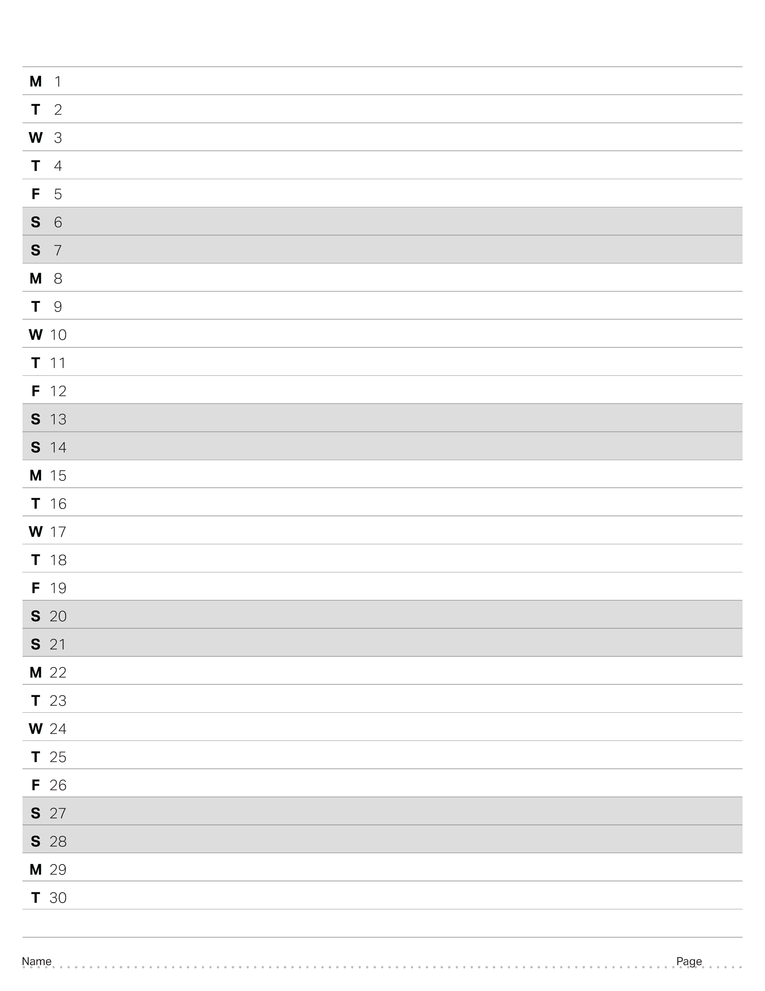
April 2024

Slide 36
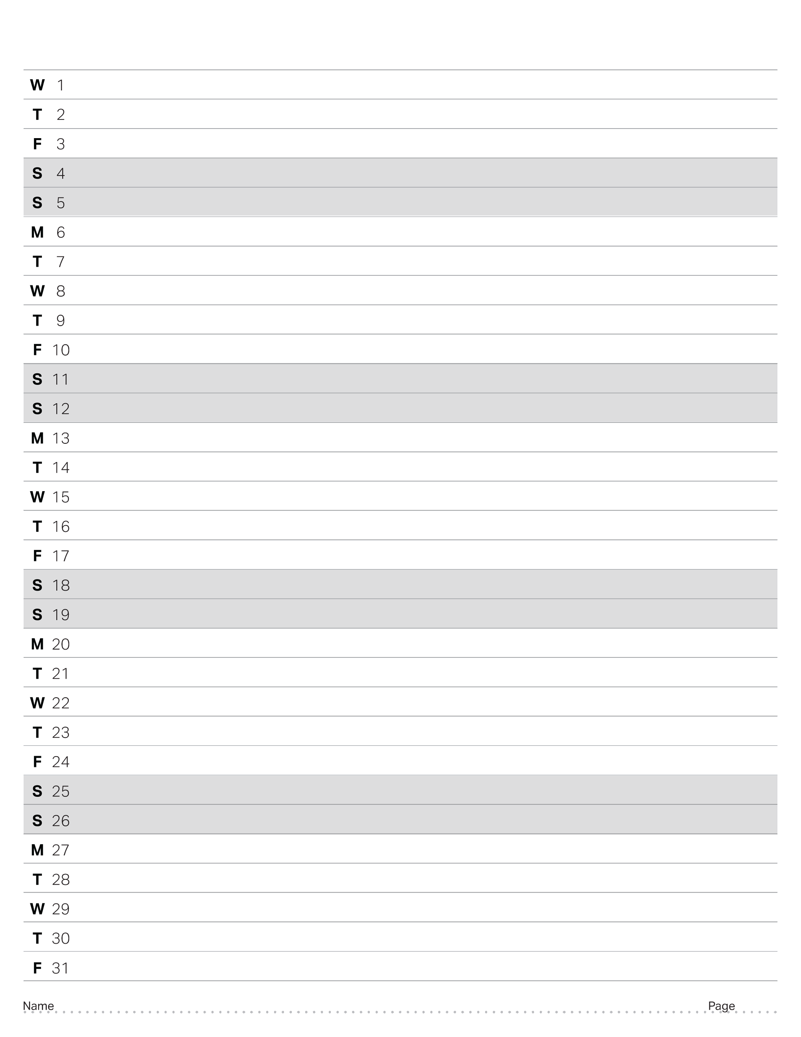
May 2024

Slide 37
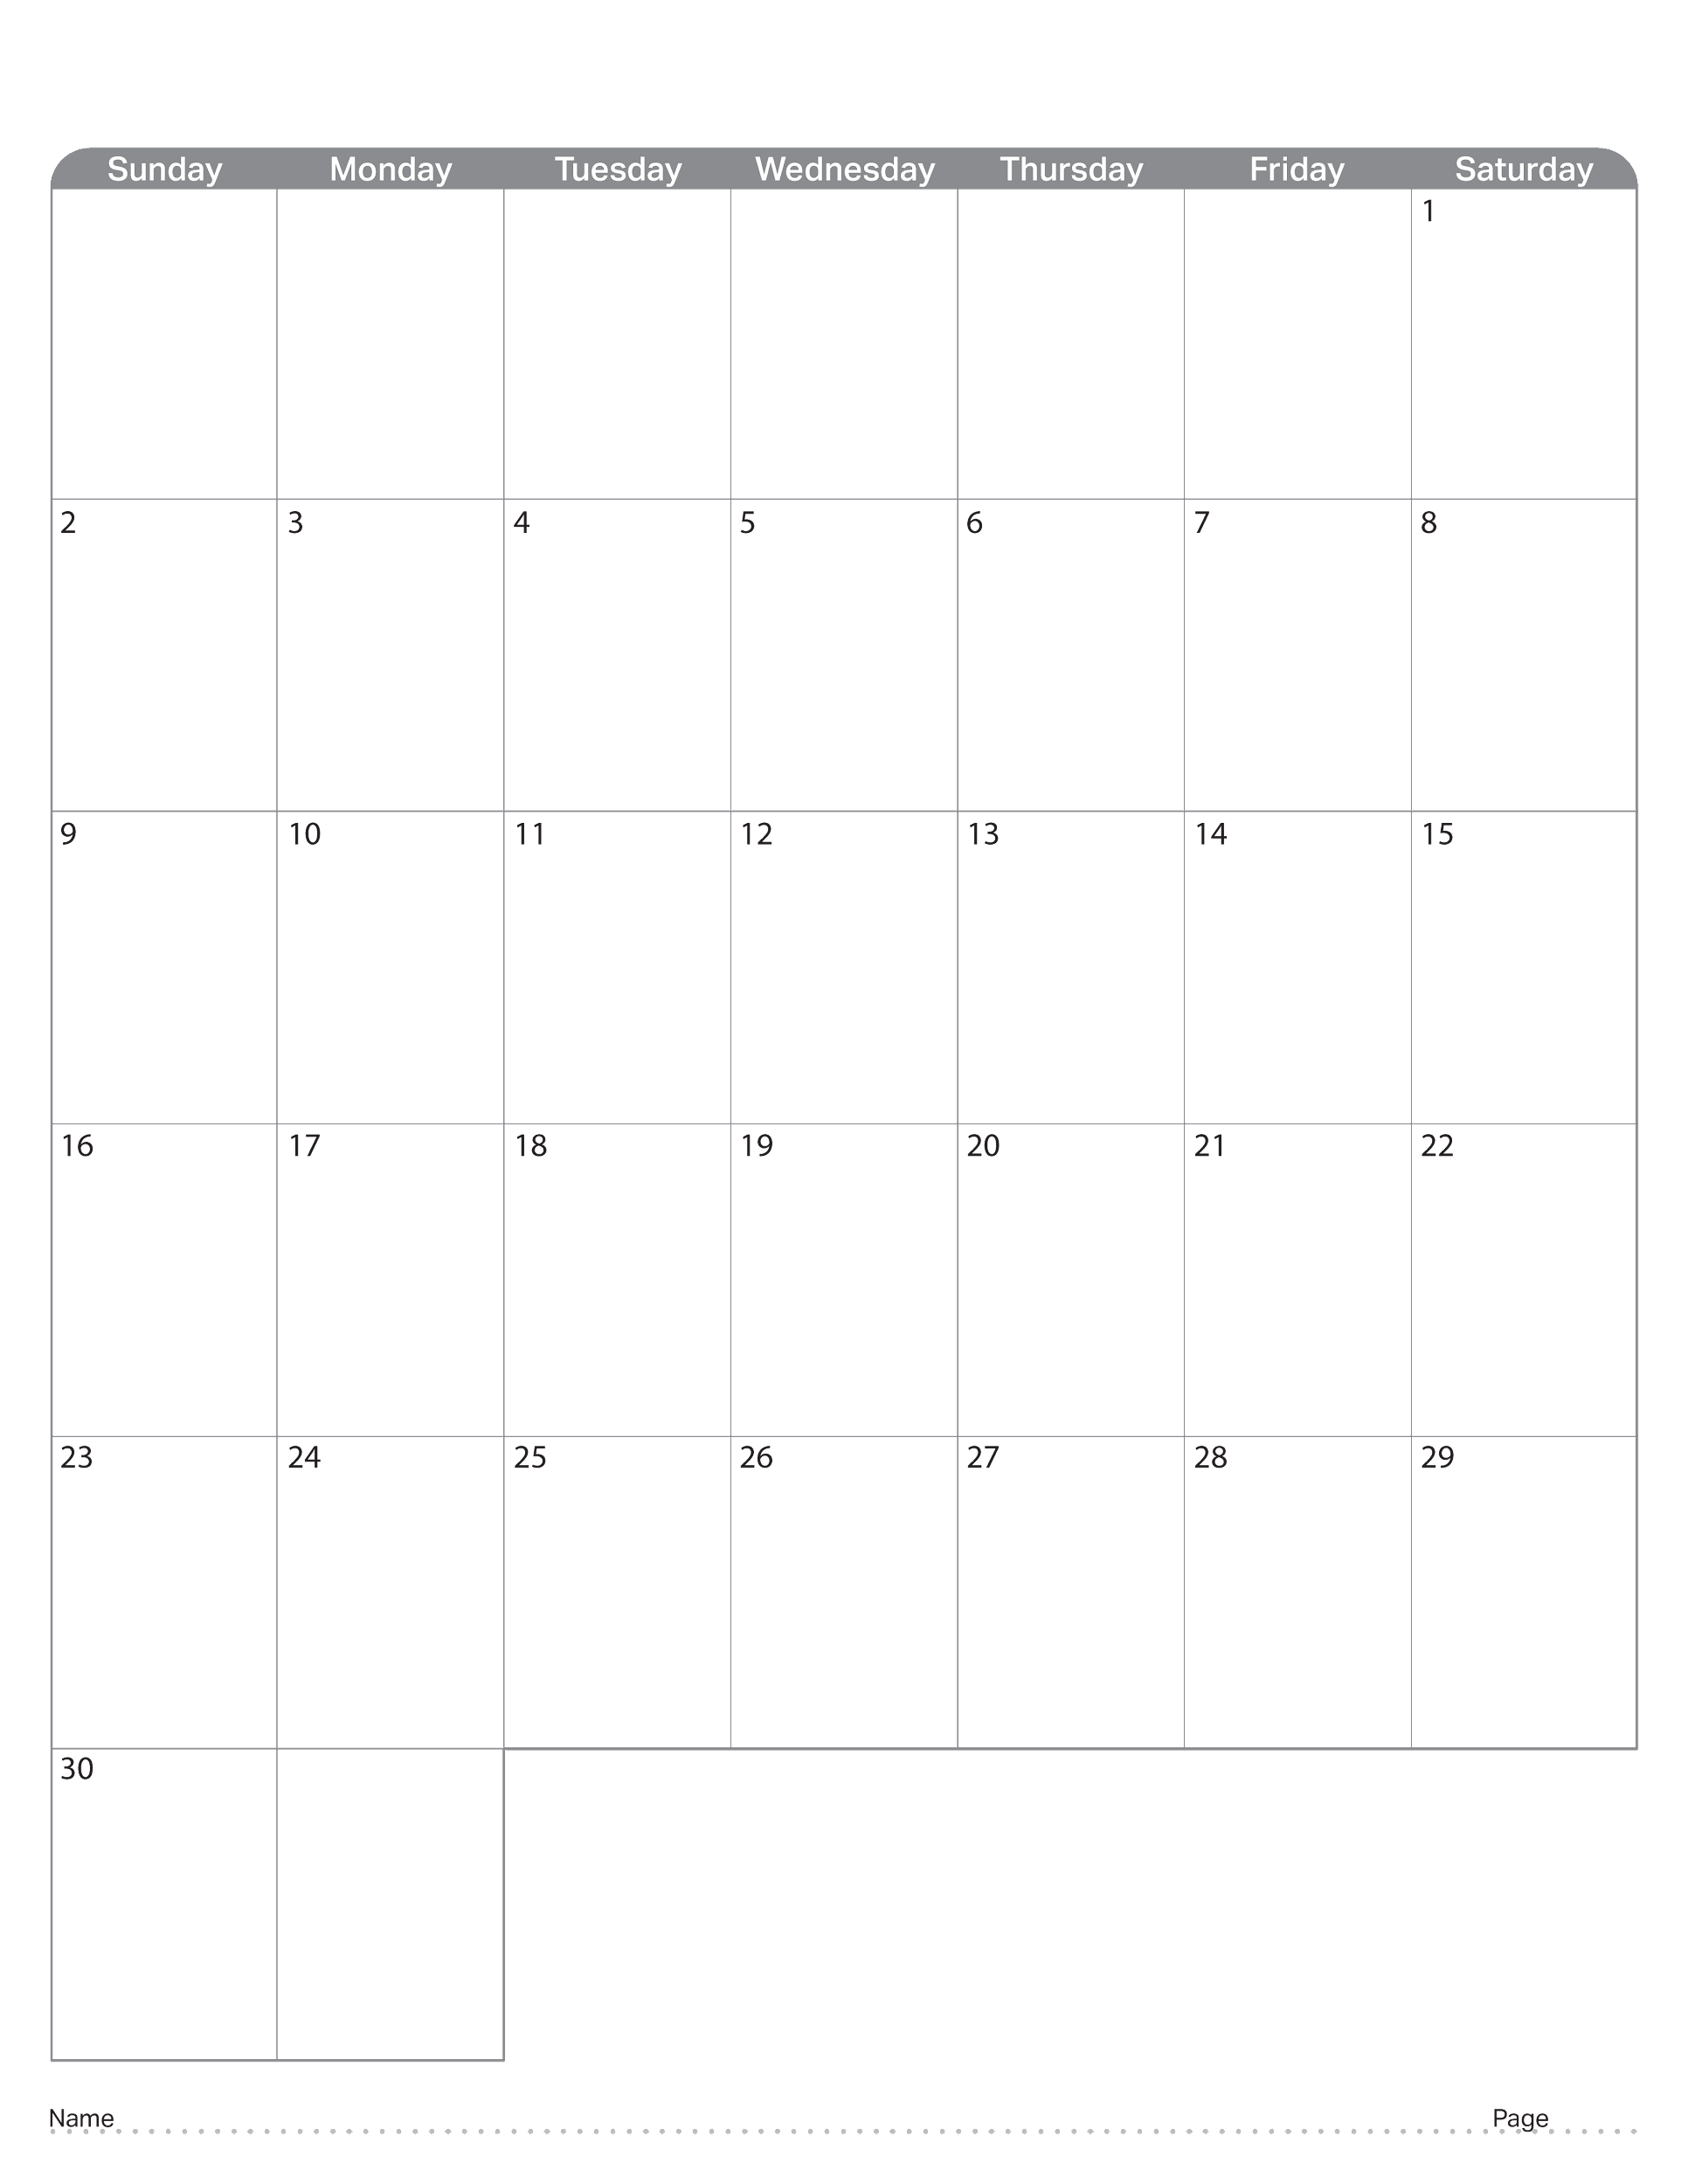
April 2023

Slide 38
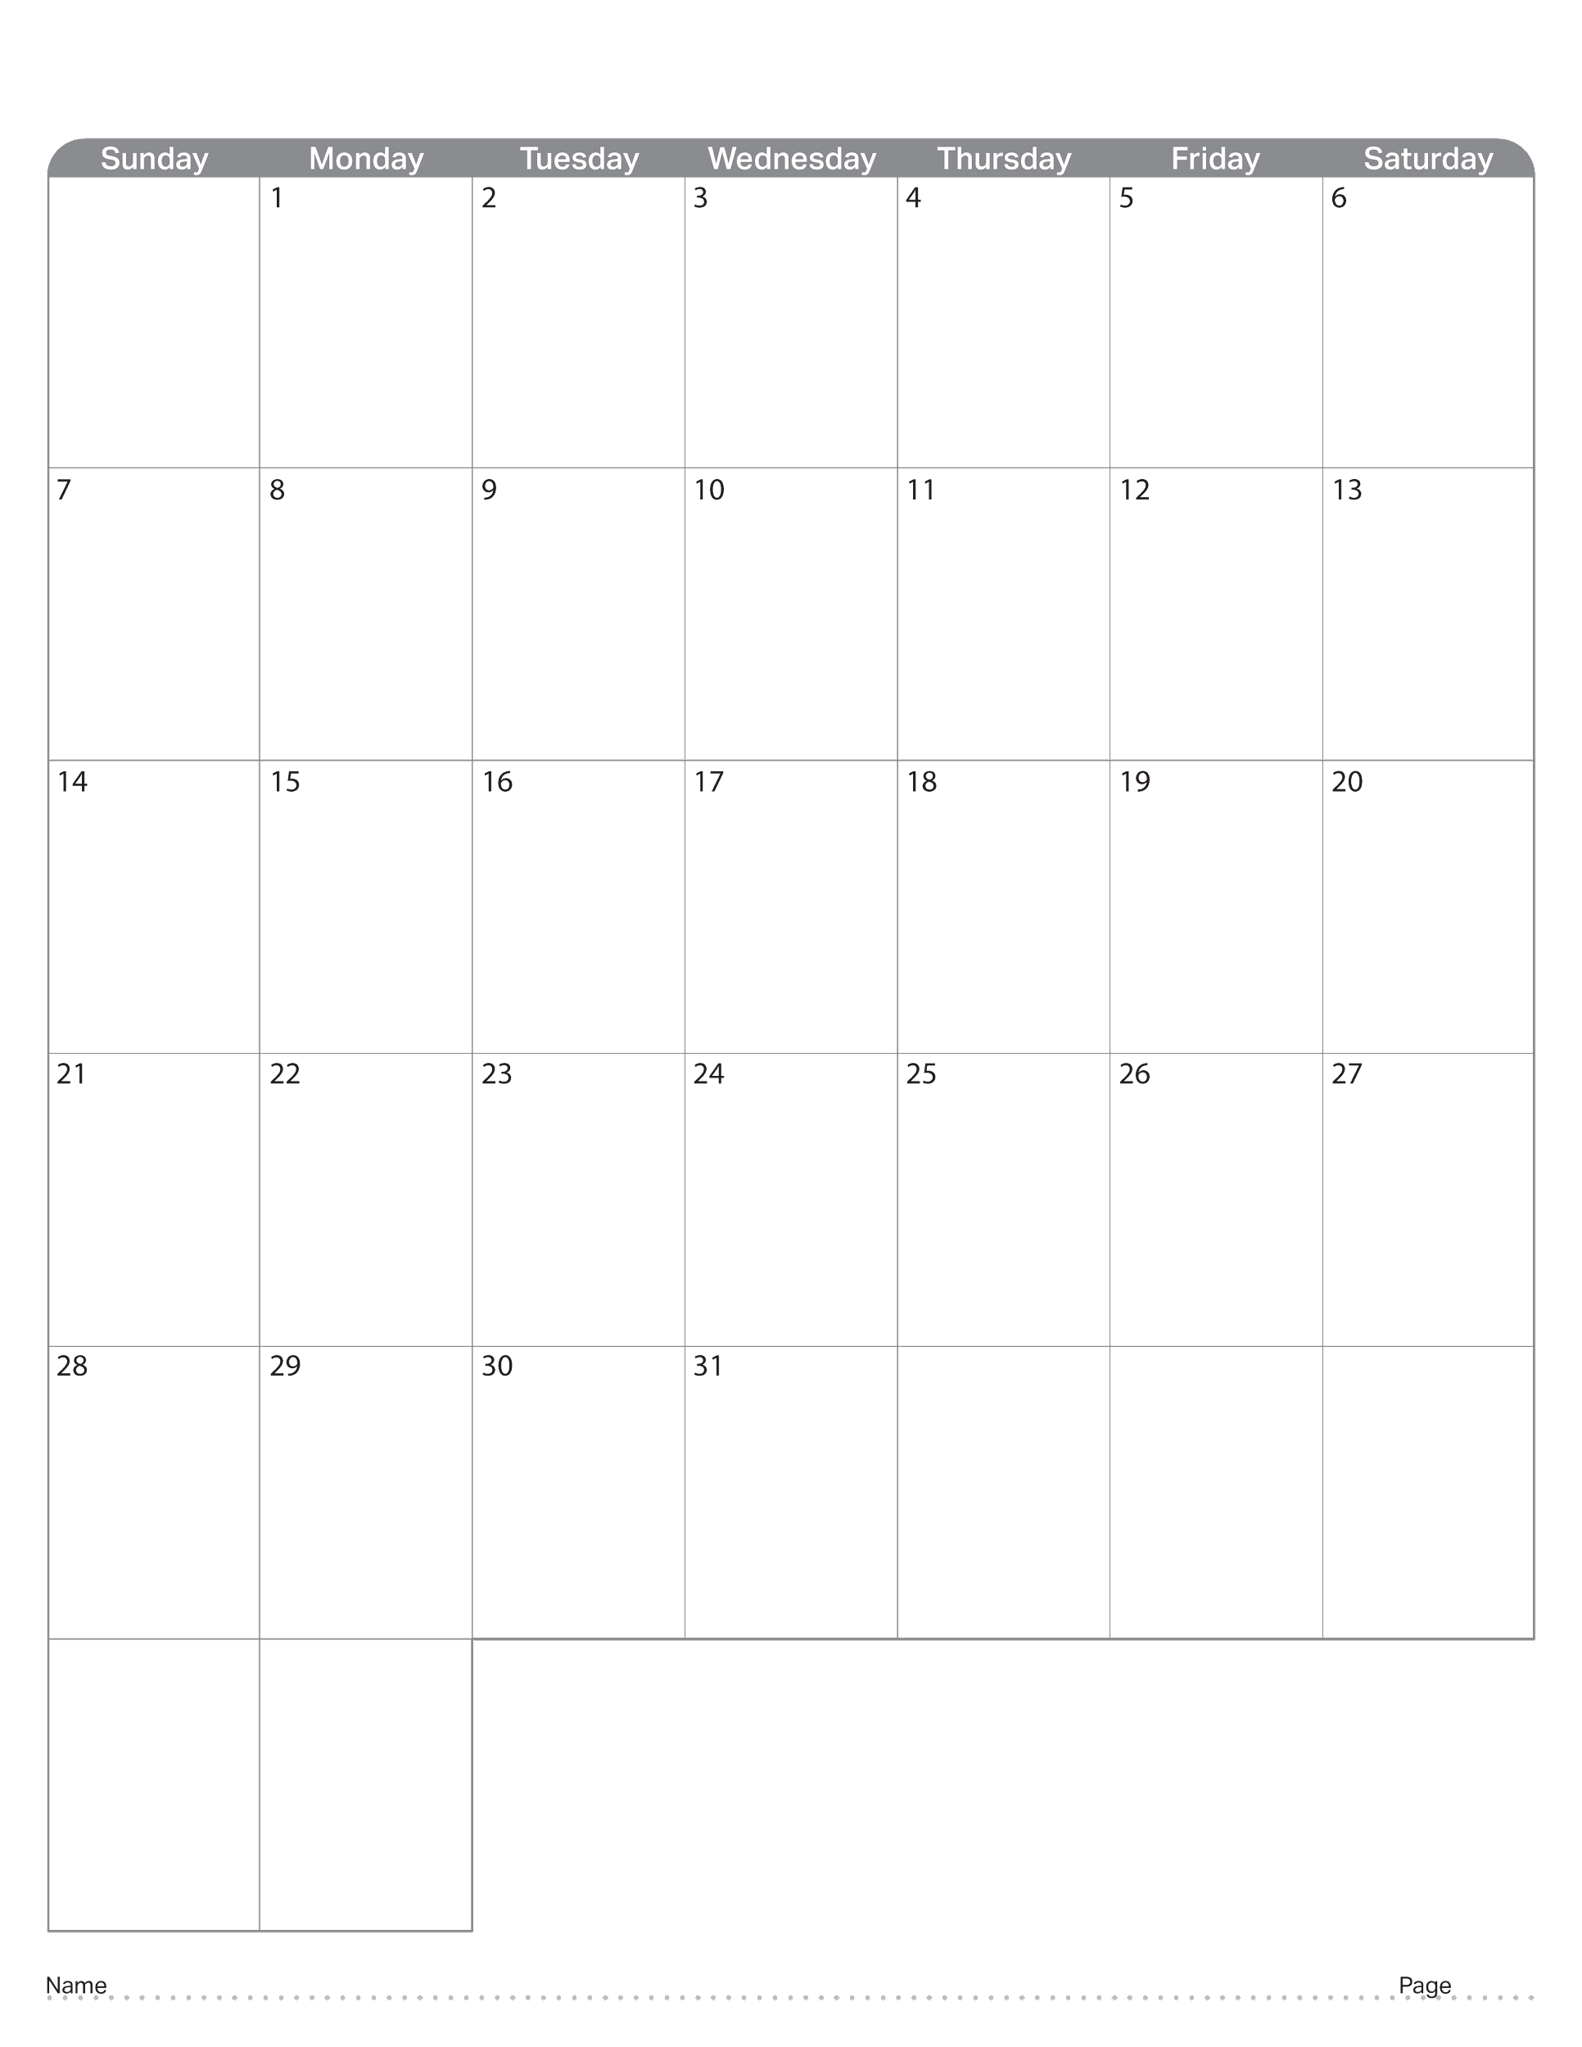
May 2023

Slide 39
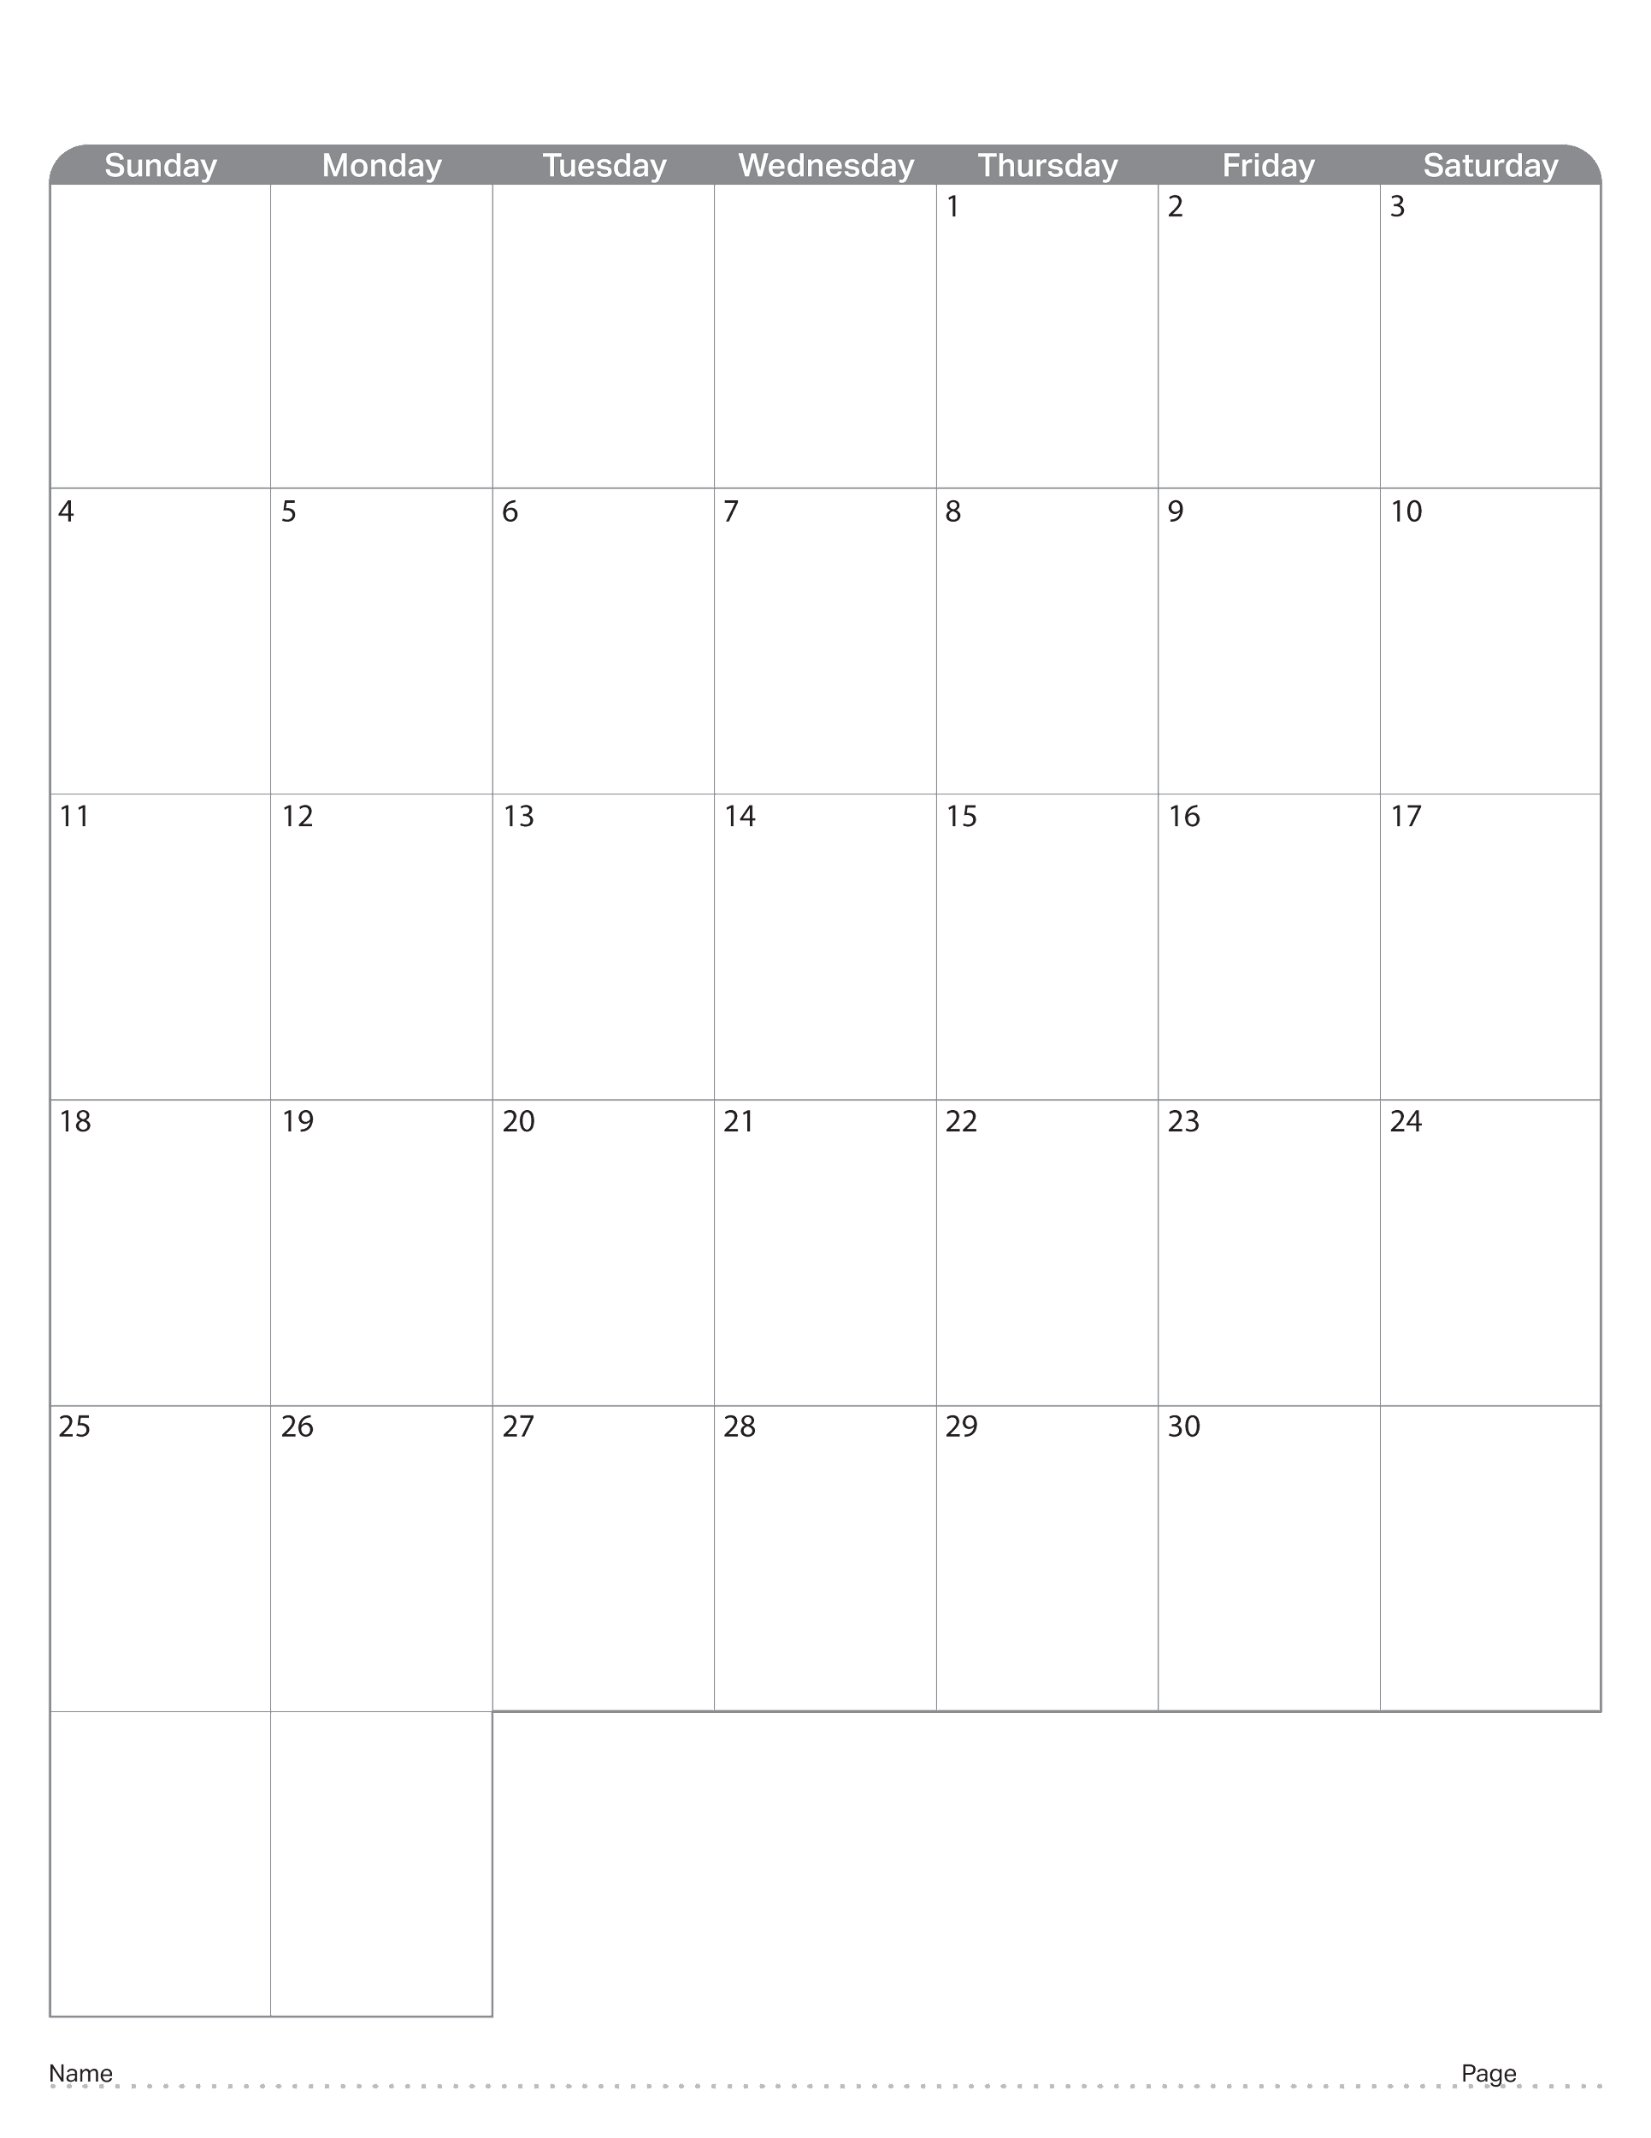
June 2023

Slide 40

July 2023

Slide 41

August 2023

Slide 42

September 2023

Slide 43
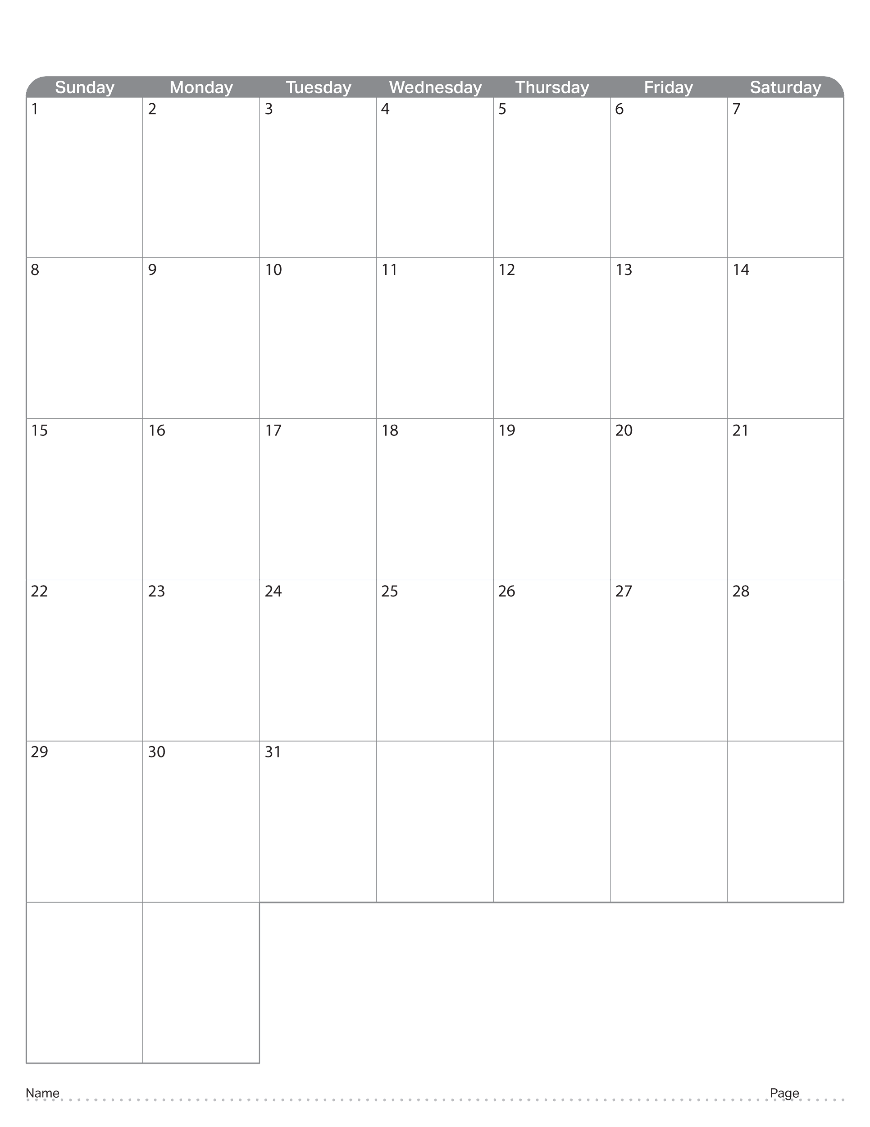
October 2023

Slide 44

November 2023

Slide 45

December 2023

Slide 46

January 2024

Slide 47

February 2024

Slide 48

March 2024

Slide 49

April 2024

Slide 50
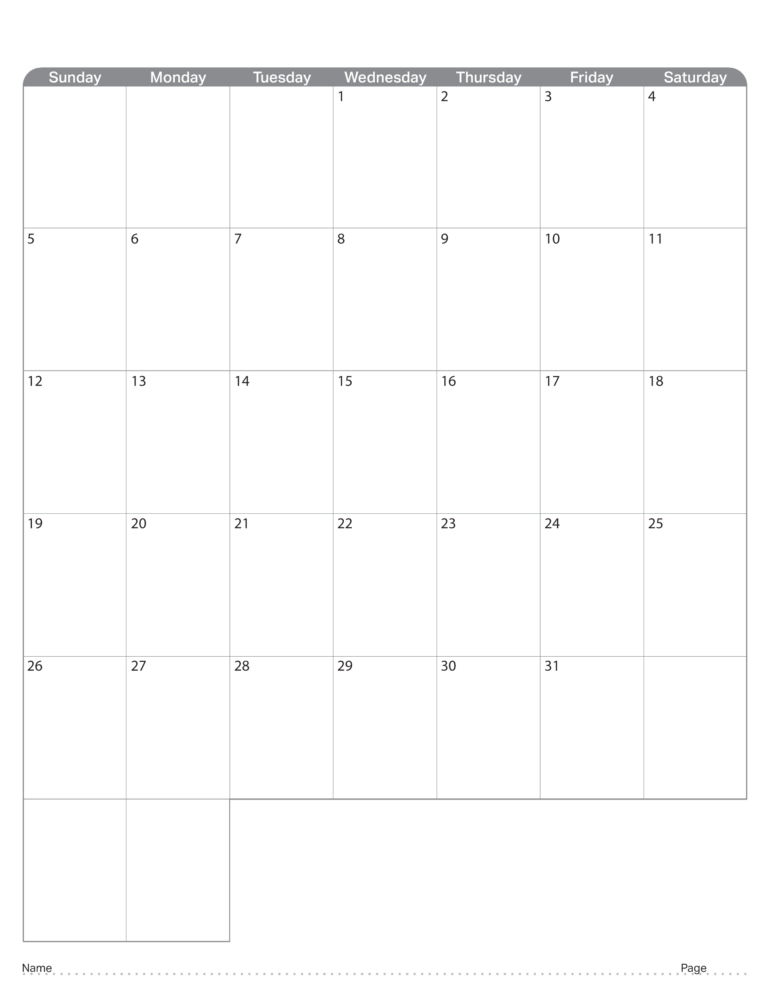
May 2024

